Slide 1
Overview of Running a JACoW Member Conference

Slide 2
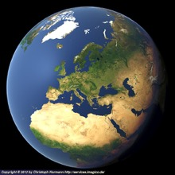
Overview of a JACoW Member Conference
Overview of this overview
Provide broad overview of conference organization
Who does what, when, where, why, and how (and to whom)
Identify committees and key roles
Describe scientific, industrial, student, and social programs
Describe activities to prepare for and execute the conference, and deliver the proceedings
Include abstracts, papers, author feedback
How does conference organization relate to JACoW?
“A semi-newcomer’s soup to nuts point of view”
This is not a talk about identifying/setting up roles in SPMS/Indico
Talk to, or set up a meeting with, JACoW BoD folks separately
JACoW
(You are (not?) here)

Slide 3
Caveat: All Conferences Great and Small
Not all conferences or workshops are the same
Here I present some commonalities among many member JACoW conferences and workshops
The best authority for how things are done for any given series is someone who has done it before
Consistent with the JACoW continuity model
Caveat audientia: Your presenter has (strong) IPAC biases
Many meetings can be (and often are) supplanted by informal organizational processes
Phone calls, meetings at other conferences, email, etc
In the acronym of Larry Wall (designer of Perl): TMTOWTDI
(There’s More Than One Way To Do It)
(Don’t even get me started on TMTOWTDIBSCINABTE)

Slide 4
Committees etc
Organizing Committee (OC)
SAB, Prize Committees, …
Scientific Program Committee (SPC)
Supreme
Executive
Authority
(for series)
Local Organizing Committee (LOC)
Organize
Scientific
Program
Can be large with a central
Coordination Committee
down to very small for workshops
Implement
Conference
Local Details
JACoW Organization
Resource to
Produce/Publish
Proceedings
Who meets when?
Notes:
May also be SAB

Slide 5
Committees etc
Organizing Committee (OC)
SAB, Prize Committees, …
Conference
responsibility
Scientific Program Committee (SPC)
Supreme
Executive
Authority
(for series)
Local Organizing Committee (LOC)
Organize
Scientific
Program
Can be large with a central
Coordination Committee
down to very small for workshops
Implement
Conference
Local Details
JACoW Organization
JACoW coordinates
with conference organization
Resource to
Produce/Publish
Proceedings
Who meets when?
Notes:
May also be SAB

Slide 6
Committees and Chronology
The OC meets at least once before the conference
Tours venue, provides conference mandate, etc
The SPC meets several (~3) times before the conference
Advises SPC chair on classifications
Organize scientific program, schedule, synoptic table
Recommends, selects, invites invited oral contributions
Selects contributed oral contributions from submitted abstracts
Balance scientific program: topic, geography, gender
The LOC meets many times before the conference
Organizes all venue and local items
Organizes workforce, budget, registration, web pages, IT, etc

Slide 7
JACoW’s Relationship to Committees: OC
JACoW interacts with portions of all three committees
The OC agrees to JACoW Policies
Abide by SPMS/Indico agreement (signed by conference chair)
Editors (and preferably also IT) participate in JACoW Team Meetings for least a three-year cycle
Maintains continuity, distributes load and information
JACoW publishing constraints as detailed at JACoW.org
Including abiding by Creative Commons Attribution 4.0
OC JACoW point of contact: Conference Chairs
Conference chairs are ultimately responsible for ensuring resources available for delivery of the proceedings to Editorial Board and JACoW for publication

Slide 8
JACoW’s Relationship to Committees: SPC
Through use of SPMS/Indico to organize scientific program
The SPC organizes much of its work through SPMS/Indico
Recommendations for and voting on invited speakers
Abstract submission
Recommendations for and voting on contributed speakers
Scientific program organization, including statistical balance
Paper and presentation submission
Email organization/tracking with authors and committee members
SPMS/Indico SPC coordination by Scientific Secretariat
Not explicitly a JACoW role
Should be JACoW knowledgeable and a team member
Secretariat job can be done without SPMS/Indico – but requires experience!

Slide 9
(More on Scientific Secretariat)
NB Petr’s
Comments
A concept from EPAC and European conferences
Stronger coordination than historical US “editor”
Should participate in all OC/SPC, most LOC meetings
Coordinates between all committees
Ensures good communication and continuity
Can provide expertise from organization of previous conferences
Primary SPMS/Indico administrator
Involved in nearly all functions that flow through SPMS/Indico
SPMS/Indico main function: Scientific Program Management
More on SPMS/Indico later this week
More on Scientific Secretariat in Thakonwat Chanwattana’s presentation on IPAC’22 experience

Slide 10
JACoW’s Relationship to Committees: LOC
LOC has greatest interaction with JACoW
Personnel and resource management, and budgets, are LOC responsibilities
There are many, many roles before, during, and after the conference that are necessary to support the final JACoW objective of producing quality proceedings in timely fashion
(SPMS/Indico DBA) | Conference Administrator
Scientific Secretariat | Editor / Editorial Board
Conference IT | Repository Manager
Editor / QA | Author Reception
Transparency Editor | Presentations Manager
Poster Session Manager | Registration Manager
Exhibition Manager | Registration Staff
Referees | Conference Webmaster
Student Session Organizer

Slide 11
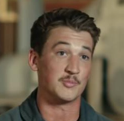
This May Seem Like A Daunting List!
And it is!
Fortunately these roles are well-documented (some in people’s heads)
There are members of the JACoW collaboration who are familiar and experienced with each function
As important as it is, LOC visibility and organization varies greatly between conferences
Some LOCs meet early and often and are very structured
Some LOCs meet late and not very often
Both can be successful
But the first is far less stressful for those engaged in doing the work of the aforementioned roles!
Experienced JACoW personnel should not obviate the need for a strong LOC (even an LOC of one or two people)
Please don't tell me
we lost an engine.

Slide 12
Conference Roles and Tasks
The following slides describe my experience with the roles of a “typical” JACoW SPMS-based conference
Which of these two movie timelines is your conference?
Chris has spoken to timelines and chronology in previous TMs
(Or Maverick with fancy flying)
https://xkcd.com/657/

Slide 13
Initial Conference Tasks
May Be
Evolving
Identify conference topic, location, hosting institution(s) and chair(s), dates
Often a matter of continuity from the series OC
Sometimes decided by a formal bid process
Identify SPC and LOC chairs
They also start gathering their committees
Final committee membership is usually approved by OC
Sign JACoW SPMS/Indico Terms and Conditions
Per JACoW.org website, delivered to chair and coordinator
Upon approval, an SPMS/Indico instance is created in the relevant geographical area, and configured with some conference info
Set up initial SPMS/Indico configs (e.g. committee lists)

Slide 14
Conference Tasks: LOC (1)
Start organizing primary LOC membership
Develop initial attandance estimates, necessary resources, and budget
Identify Professional Conference Organizer (if used)
Determine venue location options and negotate location
Start developing budgetary associations (e.g. IEEE)
Start developing visual identity, website
Start regular meetings at least 1-2 years in advance of larger conferences
Not explicitly part of the timelines talk
Learn from previous conference/workshop experiences
Organizers are improving on this in the post-COVID era

Slide 15
Conference Tasks: SPC Meetings
Formal and structured (IPACs) to informal (small conferences)
Run by SPC chair with help from Scientific Secretariat
Structures and decides scientific program
Including geographic, institutional, gender balances
Timelines discussed in previous timelines talks
Reports from, and coordination with, LOC at each meeting
IPACs:
SPC/1: Classifications, SAB membership, program structure
SPC/2: Selection of invited orals, organize invited program, plenaries and entertainment talks
SPC/3: Selection of contributed orals, poster layout, session chairs

Slide 16
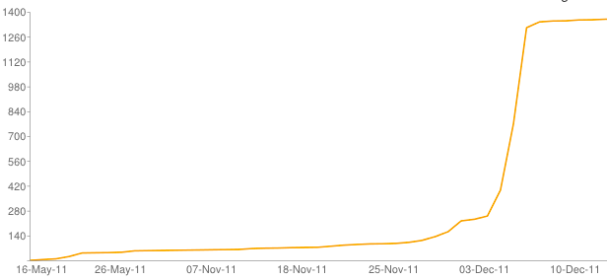
Conference Tasks: Abstracts (1)
Abstract submission deadline is usually ~4-6 months out from conference
This may vary depending on community and conference
Physicists generally work towards a known deadline
Abstracts always spike at the submission deadline
You will likely not get additional abstracts by extending the deadline at the last minute
Submitted abstracts are QA’d in preparation for SPC/3
Make them pretty and shiny to be possible contributed orals
Make sure they are in correct main classifications (quotas)
NA-PAC’11 deadline extended

Slide 17
Conference Tasks: Abstracts (2)
LOC is also very interested in abstract numbers
Used for other conference projections
Total expected registration feeds into budget projections
Advertise expected registration to attract vendors
Abstract submission is not an obligation
Typically about ~30% of abstracts are later withdrawn
So about 60-80% of submitted abstract number is a reasonable expectation for delegate registration
Also use DOE $500k limit to project max DOE attendance
(This may be a historical bias; post-COVID data is unclear.)
About 10% of total abstract number are usually candidates for the student poster session

Slide 18
Conference Tasks: LOC (2)
In parallel to SPC, the LOC is organizing many logistic and budgetary details for the conference
Editorial board
JACoW Team Meeting, training, organize team (~6 months out)
Graphic identity and web development
Bags, posters, handouts, program booklet
Venue layout and contracting
Including IT and site visit for delegate flow, mix with industry
Including AV and speaker/stage layout, acoustics
Catering and side meetings
Coffee breaks, banquet, chair’s cocktail, WISE…
Industrial registration (early to develop budget)
Delegate registration
SPMS/Indico should be used for registration if at all possible!
Student program (poster session and grants)
Companion program and registration, Tours

Slide 19
(Interlude: Student Session Organization)
http://toddsatogata.net/studentPosterOrganization.html
Student sessions are a large part of large conferences
Student Program
Acquire funding for and administer participation grants
Work with grant committee to determine awardees
Work with LOC to determine disbursement
Organize Sunday training session, secretary assignments
Coordinate student participation with Presentations Manager
Student Poster Session
Acquire funding, certificates for student poster prizes
Organize (with LOC) student poster session (usually Sunday)
Gather abstracts (grant winners must participate)
Organize SPC/OC/SPCC members as judges
Assign poster codes, produce poster session booklet
Organize rubrics and run judging session
Organize prize delivery at prize session (usually Thursday)

Slide 20
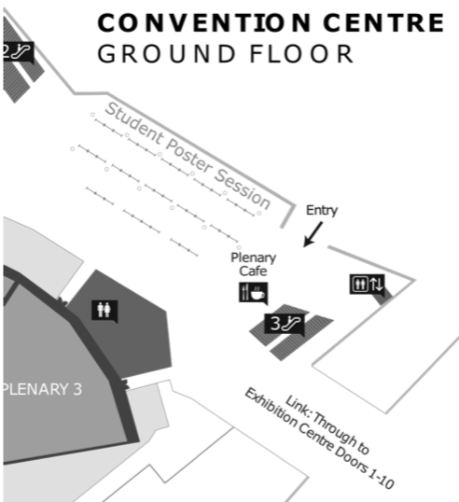
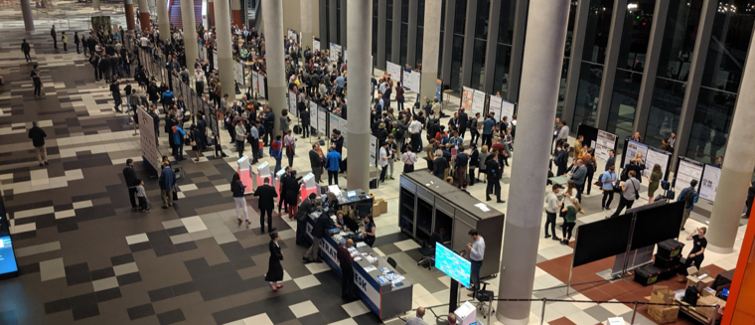
(Interlude: Student Poster Session, IPAC’19)
134 posters!

Slide 21
(Interlude: Industrial Program)
Industrial exhibitors contribute a large portion of large conference budgets
The Industrial Exhibition Manager is a very important role
Coordinates everything from registration to move-in and move-out, booths, electricity, network, carpeting, etc
It’s very important to keep exhibitors happy
Provide a venue, receptions, and poster sessions that move delegates among exhibitor booths
Provide announcements of raffles, special events, ways for industrial exhibitors to engage delegates
Have conference and SPC chair (and family?) visit booths

Slide 22
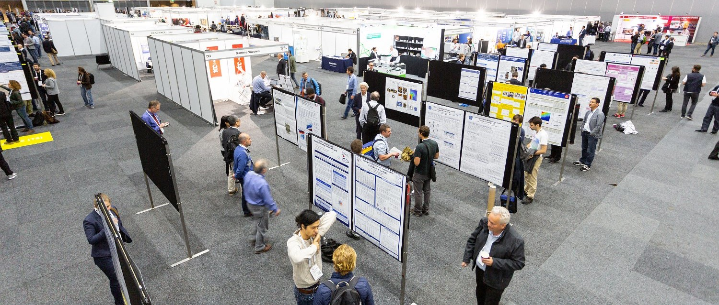
(Industrial Program/Coffee Break: IPAC’19)
Posters
Booths
Posters
Good mixing among delegates and exhibitor booths
Coffee and refreshments can force traffic through booths
Helps to have semi-enclosed booths for vendors

Slide 23
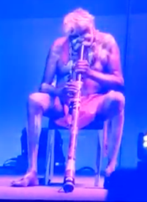
(Interlude: Social Program)
Coffee breaks should provide good opportunity for mixing
See previous photo!
Conferences can have few or many receptions
Welcome reception (Sunday evening, with student poster session)
Professional organization receptions
e.g. Meet the APS Editors at PAC/IPAC conferences
Women in Science and Engineering
Conference Banquet
Include entertainment or some interactive opportunity
e.g. Calligraphy lessons at IPAC’13
e.g. Aboriginal music and dance at IPAC’19
Companion programs and tours
Interesting cities often offer good deals for large conferences

Slide 24
Conference Tasks: JACoW
What is JACoW’s role in all this?
SPMS/Indico
Organizes scientific program and registration functions
JACoW provides guidance in SPMS/Indico function and use
Scientific Secretariat
Coordinates many SPC/LOC activities
Implements many activities in SPMS/Indico
Contacts JACoW for technical support (e.g. registration forms and payment module)
IT integration
Website scripts provide dynamic view of conference activities from metadata in SPMS/Indico
Interactive industrial registration, delegate registration lists

Slide 25
Conference Tasks: Nearing the Conference
A few months before the conference
SPC
Mainly ballistic, though some chairs and talks may change at the last minute
Scientific program must be fixed in time to print program guide
LOC
Final identification of conference team and roles
Detailed arrangements for visiting staff (e.g. editors)
Order final conference materials (booklets, bags, badges, …)
Final confirmation of all support contracts (IT, booths, …)
Dry runs of certain activities can be very helpful
Particularly with regards to transportation and logistics

Slide 26
Conference Tasks: Showtime!!
Where the rubber meets the road
This is covered very well in many other presentations at our Team Meeting
e.g. prepress proceedings available transparently now
There should always be a closeout meeting near the end of the conference
Includes LOC members, future organizers in series
Prompt documentation of lessons learned, observations
Produce written documentation of these lessons as part of conference deliverable
Remember to take and gather conference photographs
Or even hire a professional conference photographer

Slide 27
(Conference Roles: Editors)
May Be
Evolving
Editorial Board
Develop/document editorial standards for editors
Organize and invite editorial team; plan editorial rom
Participate in JACoW Team Meeting and training activities
Editor / QA
Process paper contributions according to editorial guidelines
Perform quality assurance on processed papers
Have access to Editorial module in SPMS/Indico
Transparency Editor
Process transparencies for talks to PDF, including animations
Have access to Presentations module in SPMS/Indico
Author Reception
Interface with delegates for editorial questions
Check title/author lists vs SPMS/Indico, gather copyright forms

Slide 28
(Conference Roles: IT)
May Be
Evolving
Conference IT
Set up, monitor, and break down network connectivity
Specify connectivity requirements to venue/IT vendors
Isolate editorial network from delegate network
Support network for presentations management/delivery
Participate in JACoW Team Meeting and training activities
Conference Webmaster
Maintain conference website, provide access and updates
Integrate with JACoW dynamic content (scripts)
SPMS/Indico DBA
JACoW SPMS/Indico database administrators
Can provide technical help with SPMS/Indico (and even development) before and during conference

Slide 29
(Conference Roles: Floor Managers)
Presentations Manager
Organize and run speaker ready room
Ensures presentation sessions run smoothly
Coordinate chairs and student secretaries in sessions
See Vincent’s talk Thursday for tons of useful guidance
Poster Session Manager
Organizes boards, numbering, layout
Ensures posting material is available
Ensures boards are prepared every morning for new posting
Addresses layout issues
Organizes “poster police”
Industrial Exhibition Manager
Ensures industrial exhibitors are happy
Infrastructure: light, internet, electricity, chairs, tape, etc

Slide 30
Conference Chronology: Post-Conference
Produce and publish proceedings (editorial board)
Including Preface from conference, SPC, LOC chairs
Including selected photographs
Do not let late authors control your proceedings delivery
Close out conference financials
Update website with final conference information
Including attendance and processing statistics
Treat your local volunteers to something nice
e.g. employee recognition at BNL after NA-PAC’11

Slide 31
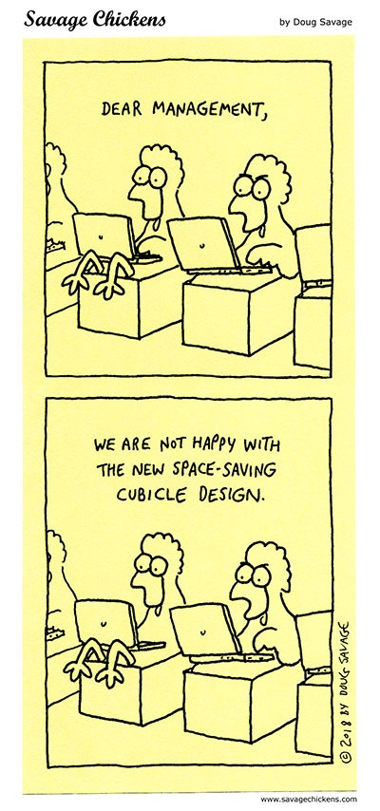
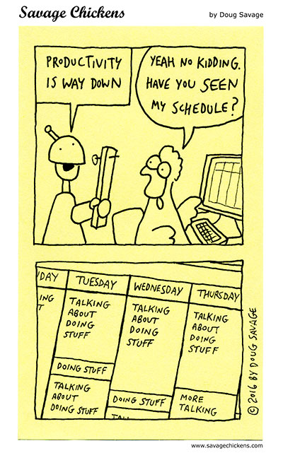
Feedback Is Necessary To Learn (but not too much)

Slide 32
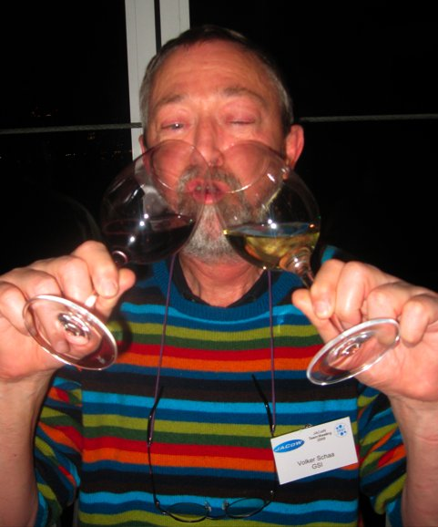
The JACoW Family Handle Stress Well!
The JACoW leadership method for stress reduction (2009)

