Slide 1


Overview of Running a JACoW Member Conference
Todd Satogata
Jefferson Lab

Slide 2

Overview of Running a JACoW Member Conference
Todd Satogata
Jefferson Lab
Or Come to the Dark Side, We Have Cookies

Slide 3


Overview of a JACoW Member Conference
Overview of this overview
  Provide broad overview of conference organization
    Who does what, when, where, why, and how (and to whom)
  Identify committees and key roles
  Describe scientific, industrial, student, and social programs
  Describe activities to prepare for and execute the conference, and deliver the proceedings
    Include abstracts, papers, author feedback
How does conference organization relate to JACoW?
  “A semi-newcomer’s soup to nuts point of view”
This is not a talk about identifying/setting up roles in SPMS
  Talk to, or set up a meeting with, Chris and Todd separately
JACoW
(You are here)

Slide 4
Caveat: All Conferences Great and Small
Not all conferences or workshops are the same
Here I discuss commonalities among many member JACoW conferences and workshops
  The best authority for how things are done for any given series is someone who has done it before
Many meetings can be (and often are) supplanted by informal organizational processes
  Phone calls, meetings at other conferences, email, etc
In the acronym of Larry Wall: TMTOWTDI
  (There’s More Than One Way To Do It)
    (Don’t even get me started on TMTOWTDIBSCINABTE)

Slide 5
Committees and Groups
Organizing Committee (OC)
SAB, Prize Committees, …
Scientific Program Committee (SPC)
Supreme
Executive
Authority
(for series)
Local Organizing Committee (LOC)
Organize
Scientific
Program
Can be large with a central
Coordination Committee
Implement
Conference
Local Details
JACoW Organization
Resource to
Produce
Proceedings
Unsurprisingly, meetings and meetings,
Oh, and more meetings…
Notes:
May also be SAB

Slide 6
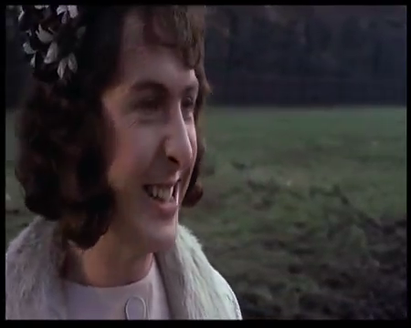
A Recent Conference Committee Meeting

Slide 7
Committees and Chronology
The OC meets at least once before the conference
  Tours venue, provides conference mandate, etc
The SPC meets ~three times before the conference
  Advises SPC chair on classifications
  Organize scientific program, schedule, synoptic table
  Recommends and selects invited oral contributions
  Selects contributed oral contributions from submitted abstracts
  Balance scientific program: topic, geography, gender
The LOC meets many times before the conference
  Organizes all venue and local items
  Organizes workforce, budget, registration, web pages, IT, etc

Slide 8
JACoW’s Relationship to Committees: OC
JACoW interacts with portions of all three committees
The OC agrees to JACoW Policies
  Abide by SPMS agreement (signed by conference chair)
  Editors (and preferably also IT) participate in JACoW Team Meetings for least a three-year cycle
    Maintains continuity, distributes load and information
  JACoW publishing constraints as detailed at JACoW.org
    Including abiding by Creative Commons Attribution 3.0
OC JACoW point of contact: Conference Chair
  Conference chair is also ultimately responsible for ensuring resources available for delivery of the proceedings to JACoW

Slide 9
JACoW’s Relationship to Committees: SPC
Mainly through use of SPMS to organize scientific program
The SPC organizes nearly all its work through SPMS
  Recommendations for and voting on invited speakers
  Abstract submission
  Recommendations for and voting on contributed speakers
  Scientific program organization, including statistical balance
  Paper and presentation submission
  Email organization/tracking with authors and committee members
SPMS/SPC coordination is done by the Scientific Secretariat
  Not a JACoW role
  Historically been a role filled by Christine Petit-Jean-Genaz

Slide 10
(More on Scientific Secretariat)
A concept from EPAC and European conferences
  Stronger coordination than historical US “editor”
Should participate in all OC/SPC, several LOC meetings
  Coordinates between all committees
  Ensures good communication and continuity
  Provides expertise from organization of previous conferences
Primary SPMS administrator
  Involved in nearly all functions that flow through SPMS
  SPMS main function: Scientific Program Management
    More on SPMS in my talk on Wednesday

Slide 11
JACoW’s Relationship to Committees: LOC
LOC has greatest interaction with JACoW
  Personnel and resource management, and budgets, are LOC responsibilities
  There are many, many roles before, during, and after the conference that are necessary to support the final JACoW objective of producing quality proceedings in timely fashion
(SPMS DBA) | Conference Administrator
Scientific Secretariat | Editor / Editorial Board
Conference IT | Repository Manager
Editor / QA | Author Reception
Transparency Editor | Presentations Manager
Poster Session Manager | Registration Manager
Exhibition Manager | Registration Staff
Referees | Conference Webmaster
Student Session Organizer | More in Weds Roles talk

Slide 12

This May Seem Like A Daunting List
And it is!
Fortunately these roles are well-documented
There are members of the JACoW collaboration who are familiar and experienced with each function
As important as it is, LOC visibility and organization varies greatly between conferences
  Some LOCs meet early and often and are very structured
  Some LOCs meet late and not very often
  Both can be successful
  But the first is less stressful for those engaged in doing the work of the aforementioned roles!
  Experienced JACoW personnel should not obviate the need for a strong LOC (even an LOC of one or two people)

Slide 13
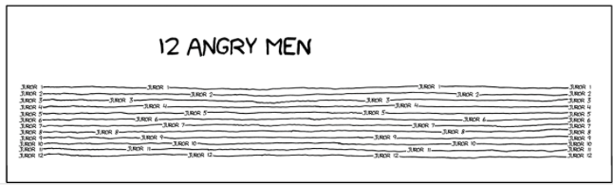
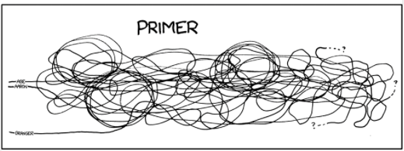
Conference Roles and Tasks
The following slides describe my experience with the roles of a “typical” JACoW/SPMS conference
Which of these two movie narratives is your conference like?
Christine will speak to timelines and chronology tomorrow

Slide 14
Conference Tasks: Initiation
Identify conference topic, location, hosting institution(s) and chair(s), dates
  Often a matter of continuity from the series OC
  Sometimes decided by a formal bid process
Identify SPC and LOC chairs
  They also start gathering their committees
  Final committee membership is usually approved by OC
Sign JACoW SPMS Terms and Conditions
  Per JACoW.org website, delivered to chair and coordinator
  Upon approval, an SPMS instance is created in the relevant geographical area, and configured with some conference info
Set up initial SPMS configurations (e.g. committee lists)

Slide 15
Conference Tasks: LOC (1)
Start organizing primary LOC membership
Develop initial attandance estimates, necessary resources, and budget
Identify Professional Conference Organizer (if used)
  NA-PAC’13 (Centennial) and IPAC’15 (Helms-Briscoe)
  IPAC’17 (Juliana) and IPAC’19 (Nicole)
Determine venue location options and negotate location
Start developing budgetary associations (e.g. IEEE)
Start developing visual identity, website
Start monthly meetings at least 1 year in advance of conference

Slide 16
Conference Tasks: SPC Meetings
Formal and structured (IPACs) to informal (small conferences)
Run by SPC chair with help from Scientific Secretariat
Structures and decides scientific program
  Including geographic, institutional, gender balances
Timelines discussed in Chris’s timelines talk
Reports from, and coordination with, LOC at each meeting
IPACs:
  SPC/1: Classifications, SAB membership, program structure
  SPC/2: Selection of invited orals, organize invited program, plenaries and entertainment talks
  SPC/3: Selection of contributed orals, poster layout, session chairs

Slide 17
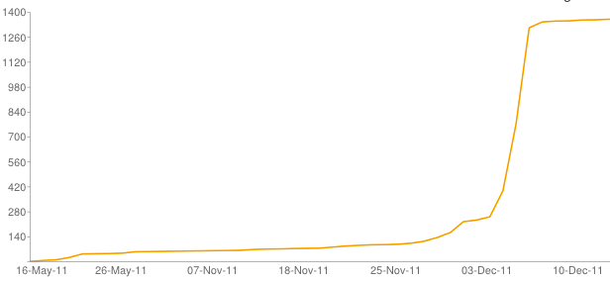
Conference Tasks: Abstracts (1)
Abstract submission deadline is usually ~6 months out from conference
  This may vary widely depending on community and conference
Physicists generally work towards a known deadline
  Abstracts always spike at the submission deadline
  You will likely not get additional abstracts by extending the deadline at the last minute
Submitted abstracts are QA’d in preparation for SPC III
  Make them pretty and shiny to be possible contributed orals
NA-PAC’11 deadline extended

Slide 18
Conference Tasks: Abstracts (2)
LOC is also very interested in abstract numbers
Used for other conference projections
  Total expected registration feeds into budget projections
  Advertise expected registration to attract vendors
Abstract submission is not an obligation
  Typically about ~30% of abstracts are later withdrawn
  So about 60-80% of submitted abstract number is a reasonable expectation for delegate registration
    Also use DOE $500k limit to project max DOE attendance
  About 10% of total abstract number are usually candidates for the student poster session

Slide 19
Conference Tasks: LOC (2)
In parallel to SPC, the LOC is organizing many logistic and budgetary details for the conference
  Editorial board
    JACoW Team Meeting, training, organize team (~6 months out)
  Graphic identity and web development
    Bags, posters, handouts, program booklet
  Venue layout and contracting
    Including IT and site visit for delegate flow, mix with industry
    Including AV and speaker/stage layout, acoustics
  Catering and side meetings
    Coffee breaks, banquet, chair’s cocktail, WISE…
  Industrial registration (early to develop budget)
  Delegate registration
    SPMS should be used for registration if at all possible!
  Student program (poster session and grants)
  Companion program and registration, Tours

Slide 20
Interlude: Student Session Organization
Student sessions are a large part of large conferences
Student Program
  Acquire funding for and administer participation grants
  Work with grant committee to determine awardees
  Work with LOC to determine disbursement
  Organize Sunday training session, secretary assignments
  Coordinate student participation with Presentations Manager
Student Poster Session
  Acquire funding, certificates for student poster prizes
  Organize (with LOC) student poster session (usually Sunday)
    Gather abstracts (grant winners must participate)
    Organize SPC/OC/SPCC members as judges
    Assign poster codes, produce poster session booklet
    Organize rubrics and run judging session
    Organize prize delivery at prize session (usually Thursday)

Slide 21
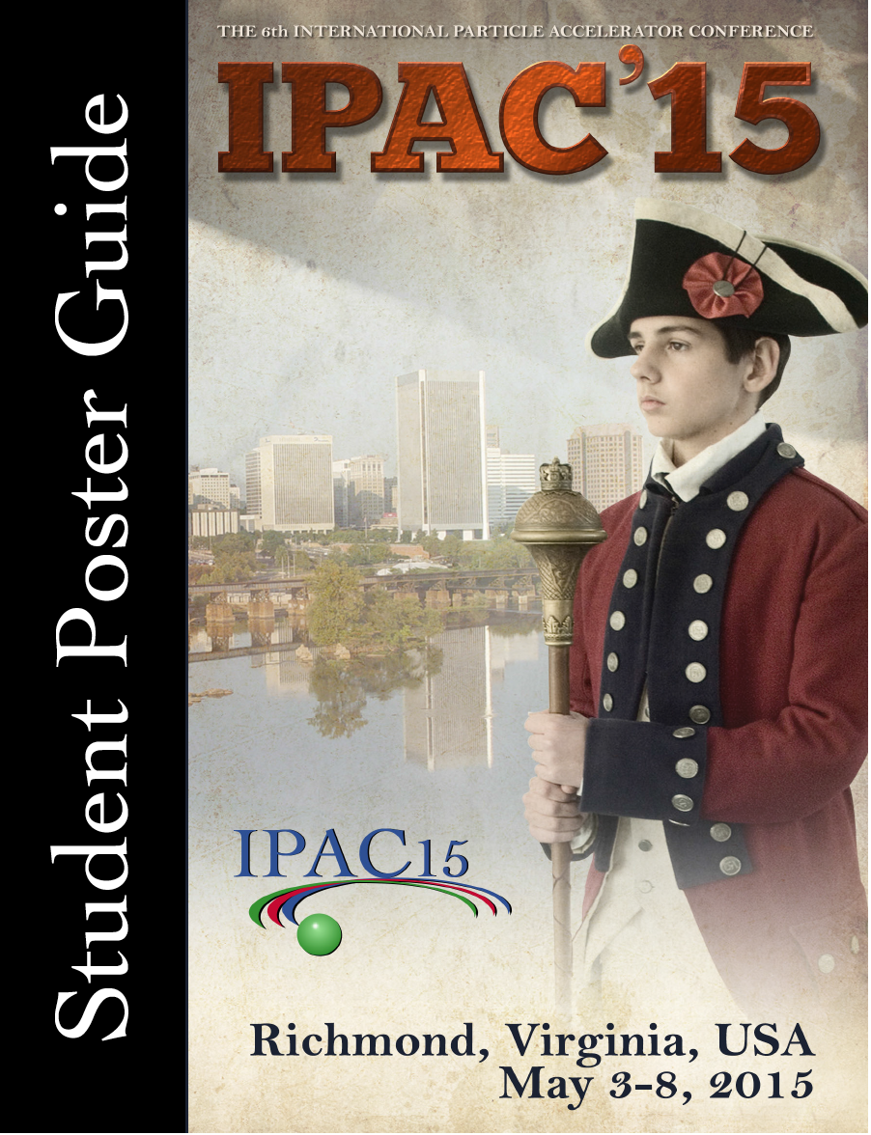
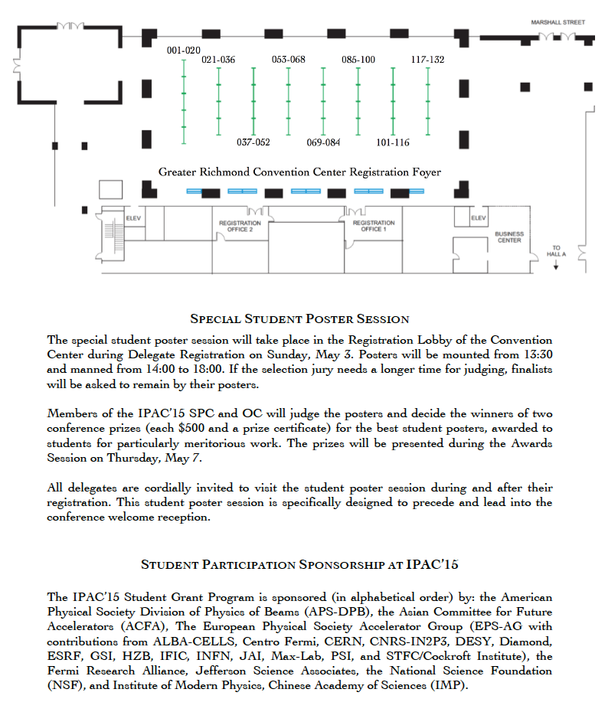
Interlude: Student Poster Session

Slide 22
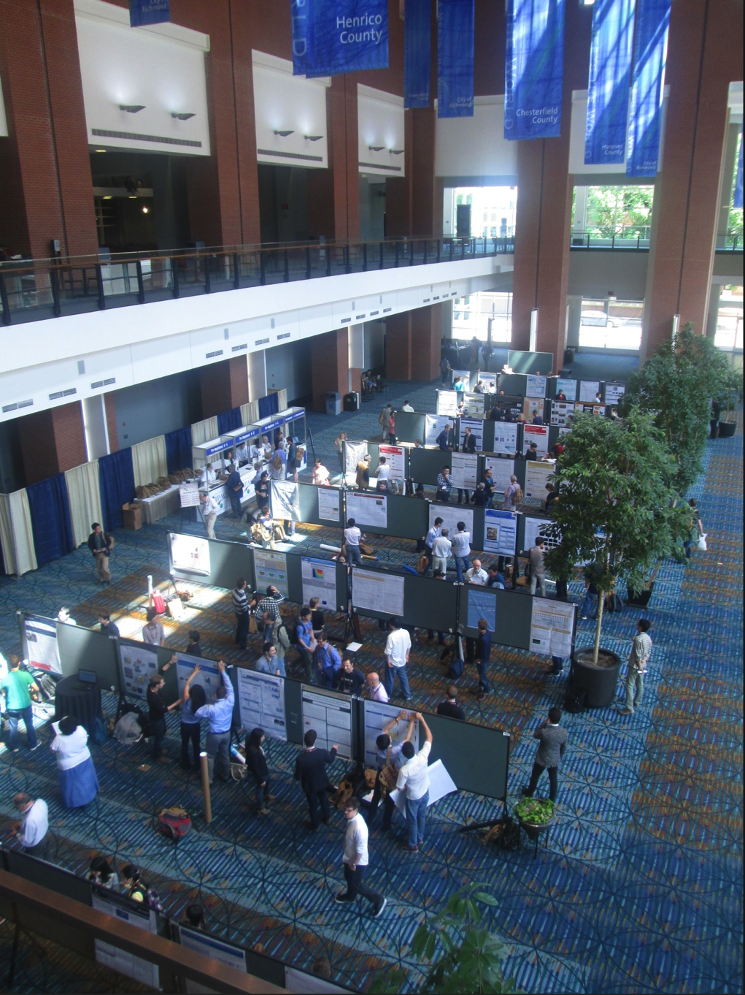
Interlude: Student Poster Session at IPAC’15

Slide 23
Interlude: Industrial Program
Industrial exhibitors contribute a large portion of your conference budget
  The Industrial Exhibition Manager is a very important role
  Coordinates everything from registration to move-in and move-out, booths, electricity, network, carpeting, etc
It’s very important to keep exhibitors happy
  Provide a venue, receptions, and poster sessions that move delegates among exhibitor booths
  Provide announcements of raffles, special events, ways for industrial exhibitors to engage delegates
  Have conference and SPC chair (and family?) visit booths

Slide 24
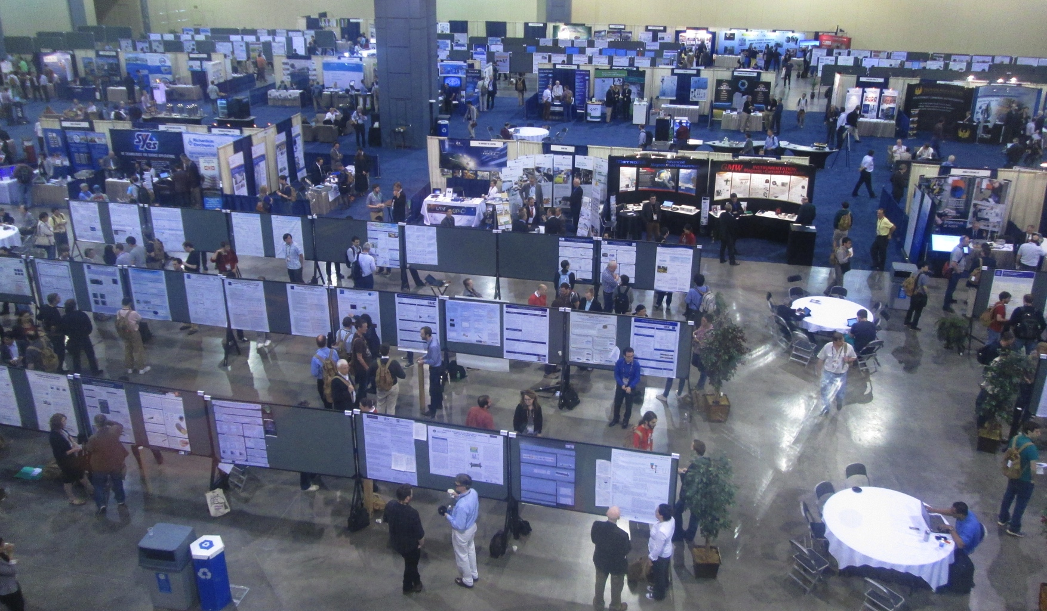
Industrial Program/Coffee Break: IPAC’15
Posters
Booths
Posters
OK mixing among delegates and exhibitor booths
Coffee in center of room forced traffic through booths
Helps to have semi-enclosed booths for vendors

Slide 25
Interlude: Social Program
Coffee breaks should provide good opportunity for mixing
  See previous photo!
Conferences can have few or many receptions
  Welcome reception (Sunday evening, with student poster session)
  Professional organization receptions
    e.g. Meet the APS Editors at PAC/IPAC conferences
    Women in Science and Engineering
  Conference Banquet
    Include entertainment or some interactive opportunity
    e.g. Calligraphy lessons at IPAC’13
    e.g. Juilliard quartet at NA-PAC’11
Companion programs and tours
  Interesting cities often offer good deals for large conferences

Slide 26
Conference Tasks: JACoW
What is JACoW’s role in all this?
  SPMS
    Organizes scientific program and registration functions
    JACoW provides expertise in SPMS function and use
  Scientific Secretariat
    Coordinates many SPC/LOC activities
    Implements many activities in SPMS
    Contacts JACoW for technical support (e.g. registration forms and payment module)
  IT integration
    Website scripts provide dynamic view of conference activities from metadata in SPMS
    Interactive industrial registration, delegate registration lists

Slide 27
Conference Tasks: Nearing the Conference
A few months before the conference
SPC
  Mainly ballistic, though some chairs and talks may change at the last minute
  Scientific program must be fixed in time to print program guide
LOC
  Final identification of conference team and roles
  Detailed arrangements for visiting staff (e.g. editors)
  Order final conference materials (booklets, bags, badges, …)
  Final confirmation of all support contracts (IT, booths, …)
  Dry runs of certain activities can be very helpful
    Particularly with regards to transportation and logistics

Slide 28
Conference Tasks: Showtime!!
Where the rubber meets the road
This is covered very well in many other presentations at our Team Meeting
  e.g. prepress proceedings available transparently now
There should always be a closeout meeting near the end of the conference
  Includes LOC members, future organizers in series
  Prompt documentation of lessons learned, observations
  Produce written documentation of these lessons as part of conference deliverable
Remember to take and gather conference photographs

Slide 29
Conference Roles: Editors
Editorial Board
  Develop/document editorial standards for editors
  Organize and invite editorial team
  Participate in JACoW Team Meeting and training activities
Editor / QA
  Process paper contributions according to editorial guidelines
  Perform quality assurance on processed papers
  Have access to Editorial module in SPMS
Transparency Editor
  Process transparencies for talks to PDF, including animations
  Have access to Presentations module in SPMS
Author Reception
  Interface with delegates for editorial questions
  Check title/author lists vs SPMS, gather copyright forms

Slide 30
Conference Roles: IT
Conference IT
  Set up, monitor, and break down network connectivity
  Specify connectivity requirements to venue/IT vendors
  Isolate editorial network from delegate network
  Support network for presentations management/delivery
  Participate in JACoW Team Meeting and training activities
Conference Webmaster
  Maintain conference website, provide access and updates
  Integrate with JACoW dynamic content (scripts)
SPMS DBA
  JACoW SPMS database administrators (e.g. Matt Arena, Ivan Andrian, Takashi Kosuge)
  Can provide technical help with SPMS (and even development) before and during conference

Slide 31
Conference Roles: Floor Managers
Poster Session Manager
  Organizes boards, numbering, layout
  Ensures posting material is available
  Ensures boards are prepared every morning for new posting
  Addresses layout issues
  Organizes “poster police”
Industrial Exhibition Manager
  Ensures industrial exhibitors are happy
  Infrastructure: light, internet, electricity, chairs, tape, etc
Presentations Manager
  Organize and run speaker ready room
  Ensures presentation sessions run smoothly
  Coordinate chairs and student secretaries in sessions
  See Vincent’s talk for more stories and details

Slide 32
Conference Chronology: Post-Conference
Produce and publish proceedings (editorial board)
  Including Preface from conference, SPC, LOC chairs
  Including selected photographs
  Do not let late authors control your proceedings delivery
Close out conference financials
Update website with final conference information
  Including attendance and processing statistics
Treat your local volunteers to something nice
  e.g. employee recognition at BNL after NA-PAC’11

Slide 33
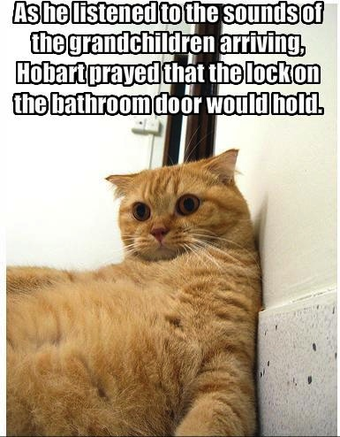
Don’t Let The Stress Get To You!

Slide 34
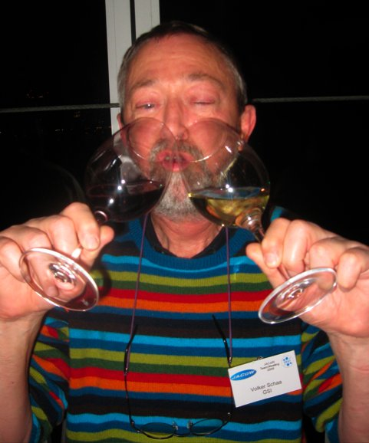
Or Enjoy It If It Does
The JACoW leadership method for stress reduction (2009)

Slide 35
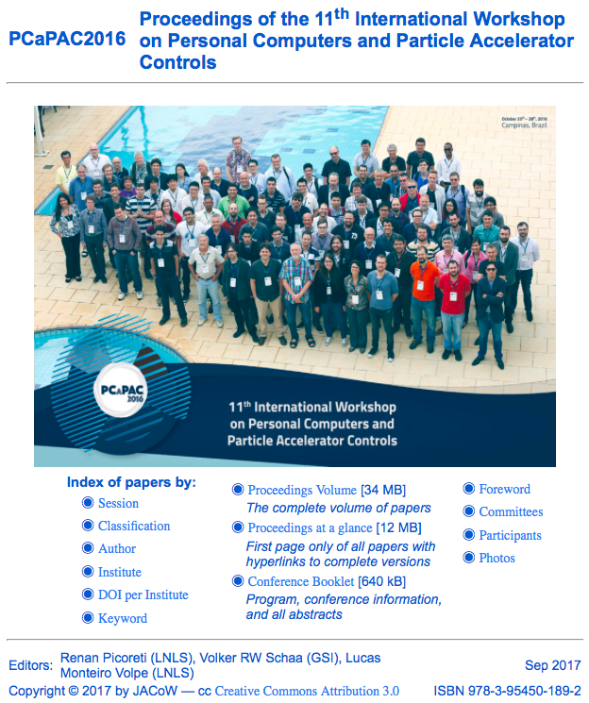
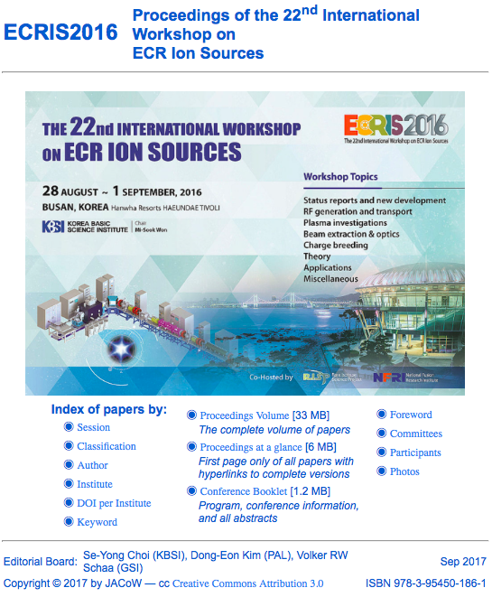
There Is Light At The End Of The Tunnel

