Slide 1
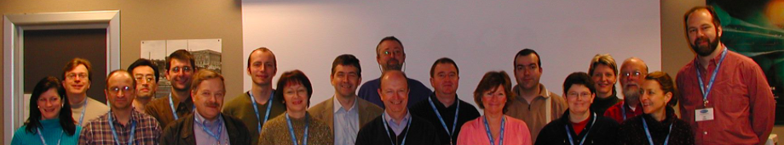

What is JACoW and
What Do We Offer To Your Conference?
Trieste
2003
Todd Satogata
Jefferson Lab and Old Dominion University
JACoW Team Meeting 2016
Beijing, China
28 November 2017

Slide 2

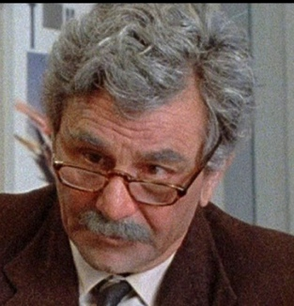
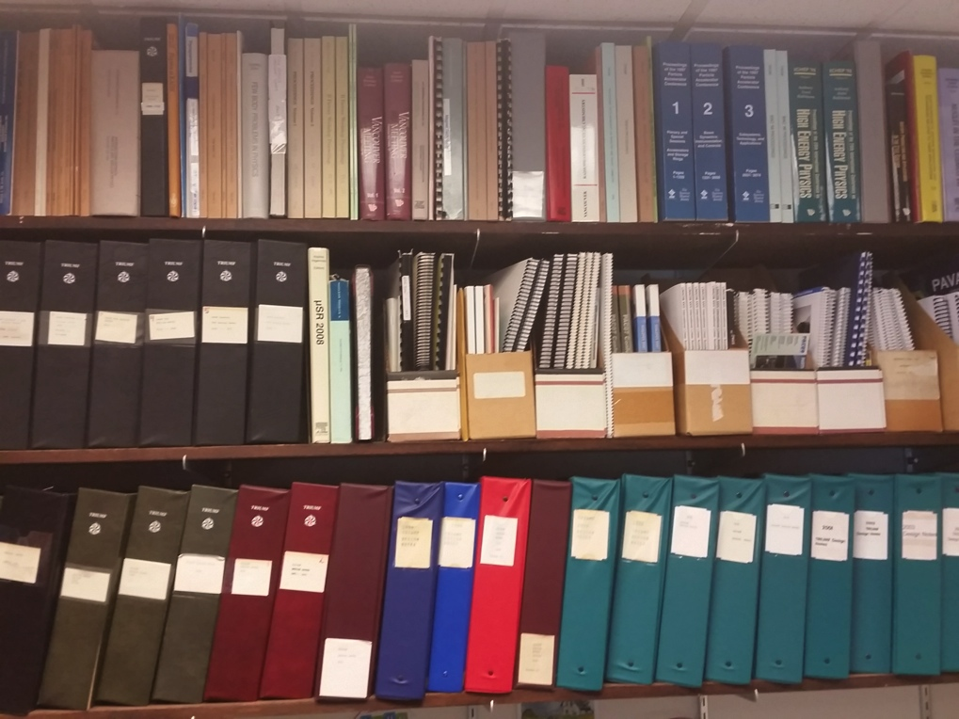
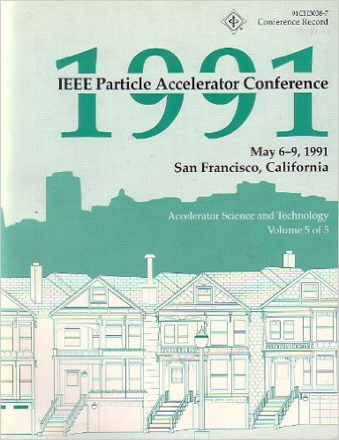
When I was your age…
…proceedings were called “books”!
Conferences once printed all their proceedings
  (Nearly) all the delegates got a printed, shipped copy
  We’d send people to conferences to get proceedings!

Slide 3

A Confluence of Technologies
And an exaltation of larks
Not to be confused with the larch
1990-1: World Wide Web (CERN)
1993: PDF and Acroread made free (Adobe)
1993: Commercialization of Linux (redhat)
1994: 100 MHz PC processors (Intel)
1995-2000: Dot Com Boom
  Internet usage/access grows 25x: 15M to 350M
  1995: Release of Windows ’95
PAC’95 (Dallas): Camera-ready publication
EPAC’96 (Sitges): Electronic publication (CERN)
  Templates, on-site editing, dot board (author “education”)
PAC’97 (Vancouver): The birth of JACoW
  Founded by APAC’98, EPAC’98, PAC’99

Slide 4
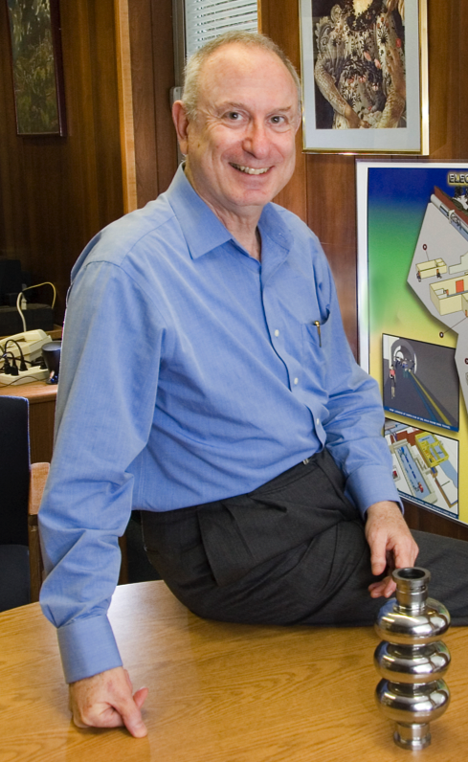
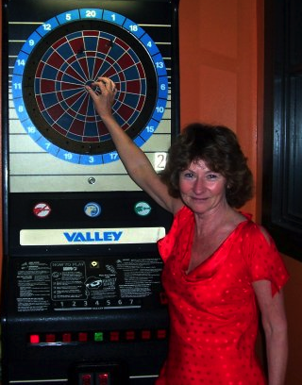
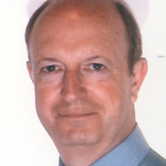
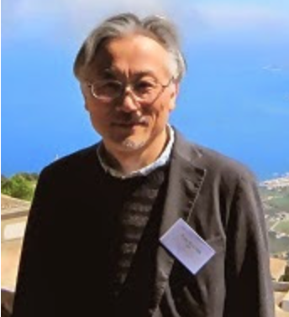
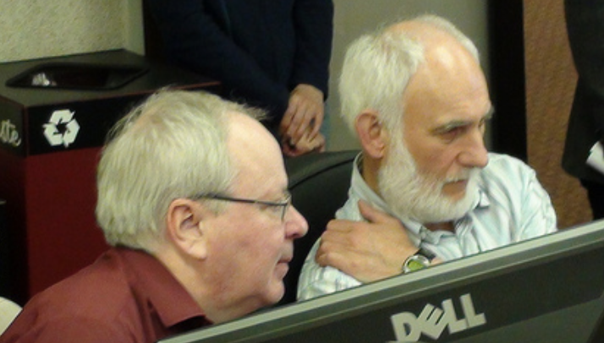
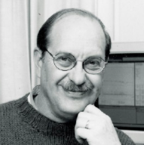
A Confluence of Personalities
PAC’99
APAC’98
EPAC’98
PAC’97
PAC’95

Slide 5
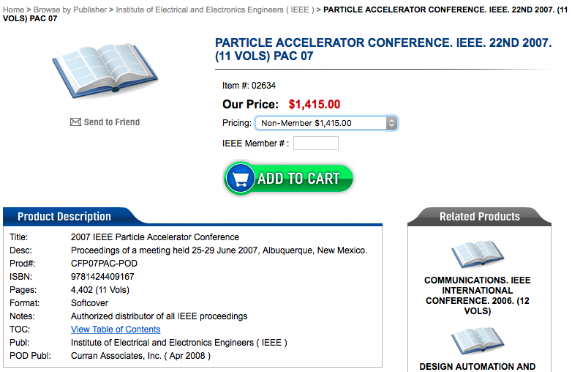
What a Deal!
Proceeding copies sold through
Curran Associates
Other hardcopies US$300-$500
for recent IPACs
A large portion of registration fee
if all delegates receive a printed
copy

Slide 6
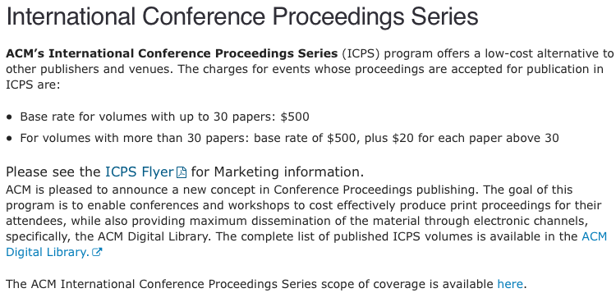
A More Rational Comp
Association for Computing Machinery (ACM) publishing arm
  $500 + $20 per paper over 30 $500+$20*1400ish = $28-30k
  Reasonably comparable to JACoW costs
  BUT they have their own copyright, and require subscription for access
JACoW is better at a comparable up-front cost (and lower total cost)
Notes:
Individual subscription cost is $99/year

Slide 7
What are the Goals of JACoW?
http://www.jacow.org/About/GoalsOfJACoW
Publish high-quality sets of proceedings with access through the custom interface.
Provide long-term archival storage to ensure longevity and access to publication data.
Publish conference metadata for open archives.
Train and educate authors and editors.
Provide and maintain a repository of user profiles for accelerator conferences.
Provide support for conference organisers.
Consistent core goals since the founding of JACoW

Slide 8
What are the Requirements of JACoW?
http://www.jacow.org/About/PoliciesRequirementsForPublishingOnJACoW
CC-BY 3.0: https://creativecommons.org/licenses/by/3.0/
Editor/IT participation in Team Meetings (3yr cycle)
Technical paper requirements
  PDFs: proper metadata / margins / paper size / font embedding / version compatibility
SPMS use not required
  Use of SPMS and repository requires agreement on repository privacy, quality, integrity
  Future is SPMS-Indico with perhaps a different model

Slide 9
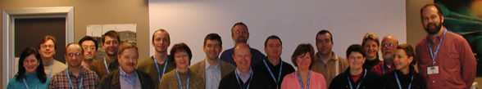
The JACoW Charter
http://www.jacow.org/About/Charter
JACoW operates according to the rules and policies of the JACoW Charter, documented on jacow.org
The charter defines less what JACoW does, and more how JACoW operates.
  Board of Directors composition, elections, responsibility and authority
  Annual Team Meeting
  Annual Stakeholder’s Meeting
    (Nearly) always at IPAC to attract broadest audience
  “The existence of the JACoW site does not detract from the rights of individual conference organisers to publish their proceedings on other web sites, storage media or hard copies of their choice.”
http://www.jacow.org/Main/Contacts

Slide 10
What is JACoW? A Website (or more)
Joint Accelerator Conferences on the Web(sites)
  Proceedings hosted by CERN and KEK
  JACoW wiki/website hosted by Elettra
  SPMS servers hosted by FNAL, CERN, KEK
  Upload/download servers hosted by PSI, Jefferson Lab
  Source code, request tracking hosted by sourceforge
    With investment in a functionality merge with InDiCo
We cannot hope to achieve our goals without the resources (hardware and time) provided by the support of national labs and conference series

Slide 11
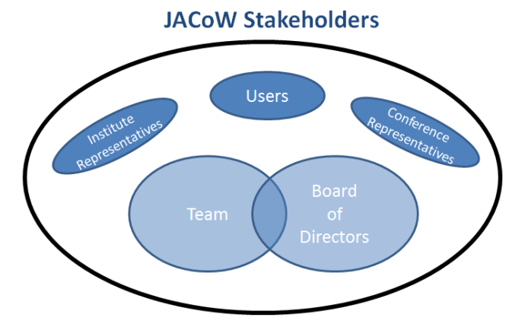
What Is JACoW? A Collaboration
http://www.jacow.org/About/TheCollaboration
JACoW is an international collaboration
  Dedicated to prompt high-quality publication of accelerator science conference proceedings
http://www.jacow.org/StakeHolders/ListOfStakeholders

Slide 12
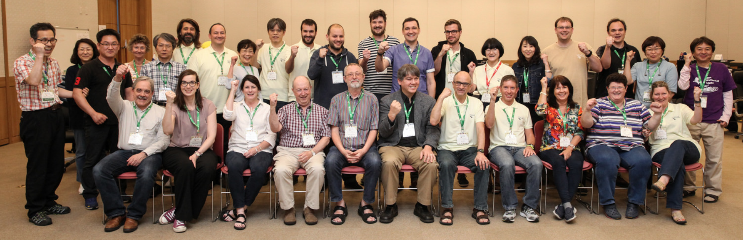
IPAC’16 JACoW Team (Busan)
http://www.jacow.org/About/TeamMembersRoles
All of us are members of the JACoW team
  Producing excellent, prompt proceedings for international conferences in good cameraderie
  Coordinating support for proceedings production
    Author reception, IT, presentation management, etc

Slide 13
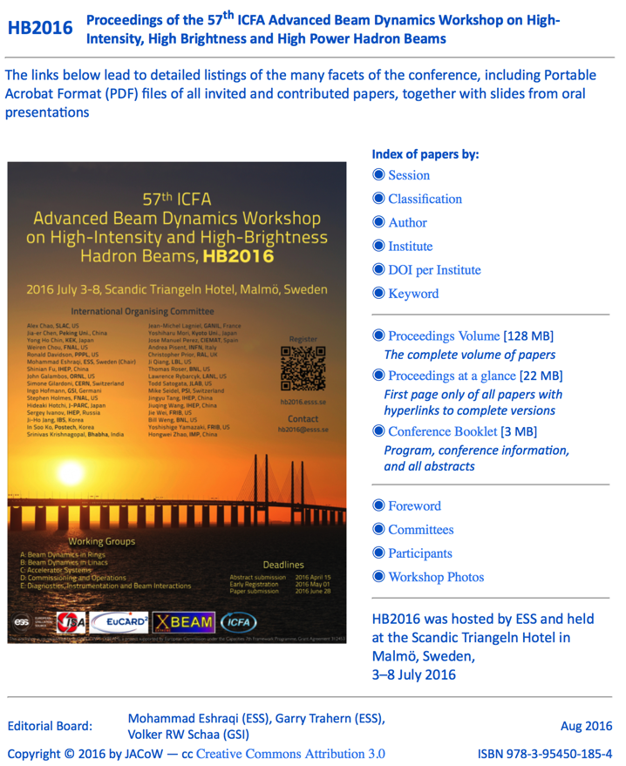
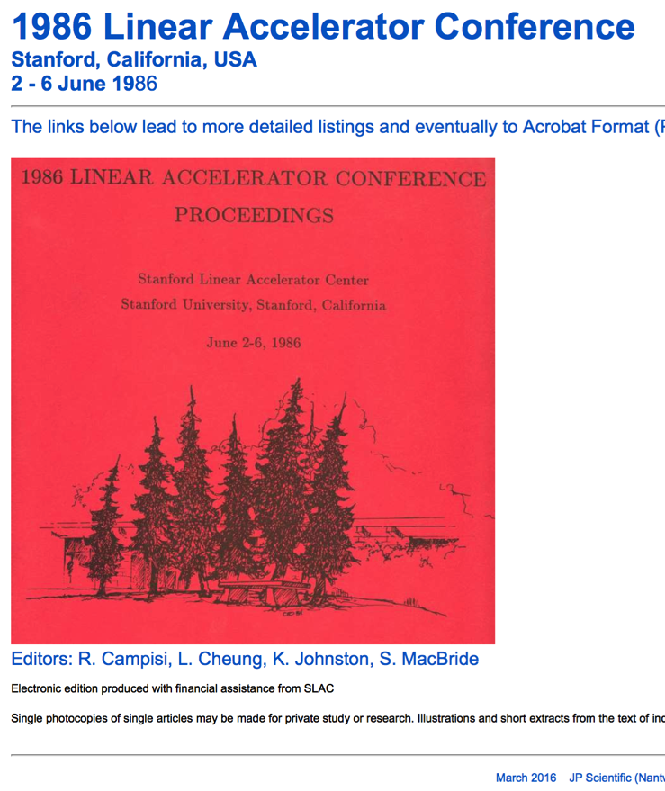
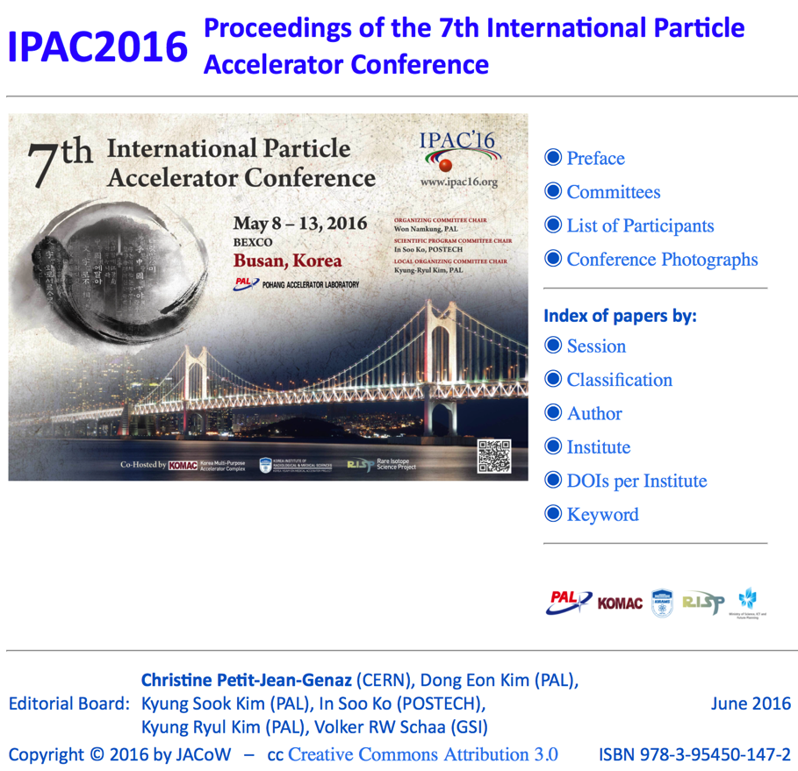
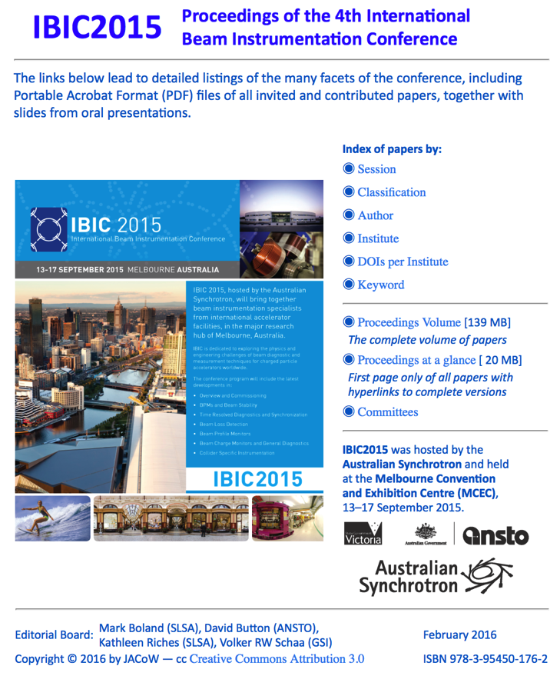
JACoW: Producing Excellent Proceedings
197 conferences
and workshops
as of this writing
18 since last TM

Slide 14
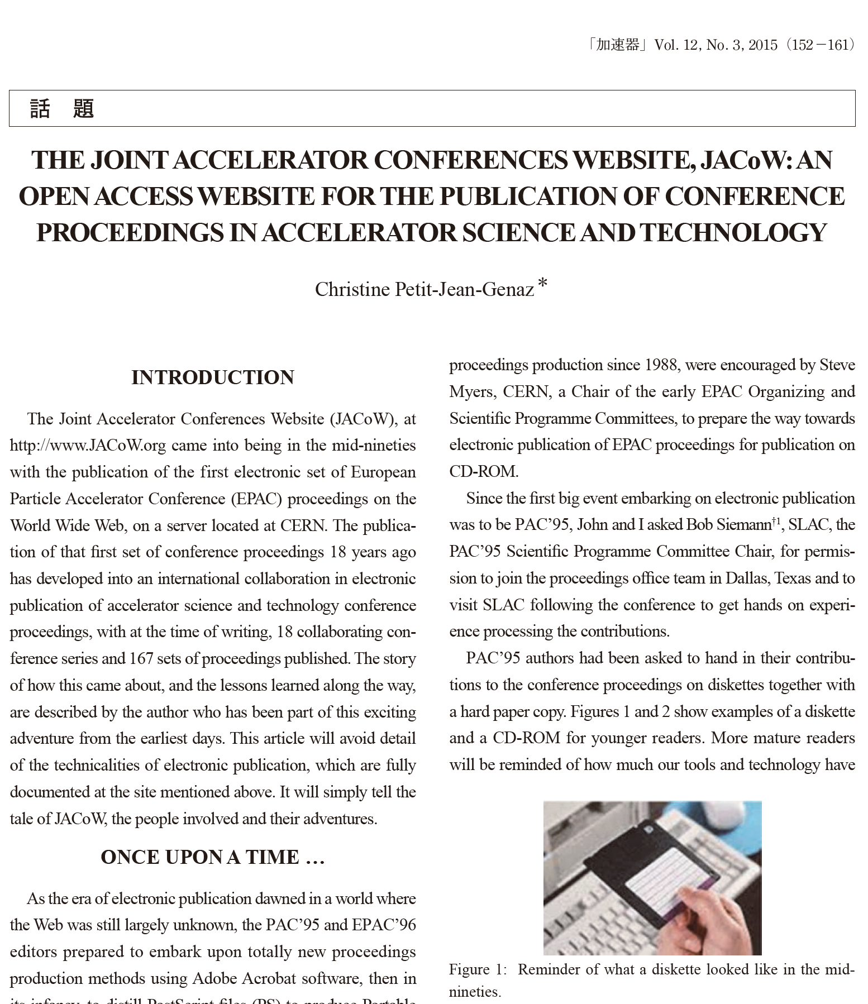
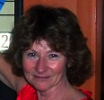
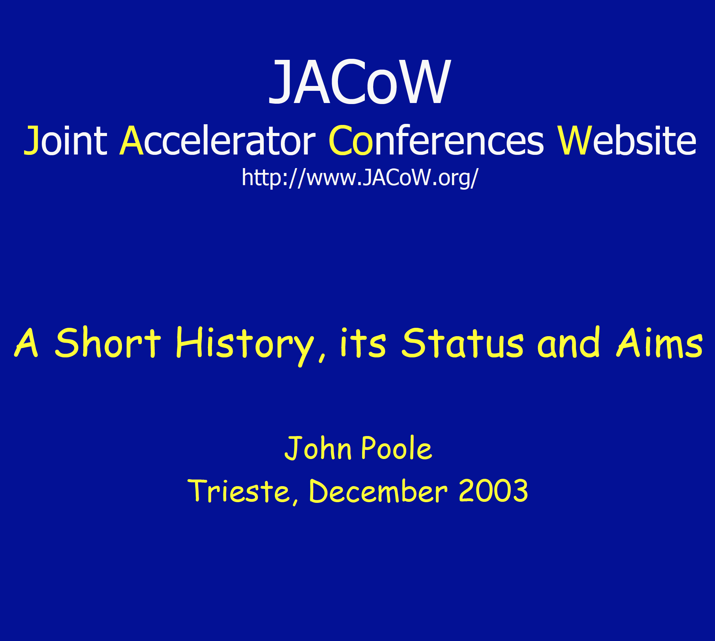
Recommended Reading
http://www.jacow.org/uploads/About/Article_KASOKUKI.pdf
Or, as Volker would put it, “Joint Accelerator
Conferences on the Web”
http://epaper.kek.jp/jacow/TM_2003_Trieste/slides/Seminar-JP.pdf

