Slide 1
Trends in paper submission, types, problems
Volker RW Schaa GSI, Darmstadt, Germany
Team Meeting 2019 — Santos, Brazil 04 Dec 2018

Slide 2
Overview
Over the years each conference and the authors as a whole within JACoW conferences have been shifting in preferred platforms, file types, and accuracy of submissions.
This talk will investigate and make comment on these evolving trends.

Slide 3
Overview
Over the years a number of changes have taken place.
Chris and Todd already gave historic overviews so this will not be repeated here.
Just one exception: You heard about Dotting Boards, so here is a picture of one at LINAC2004.

Slide 4
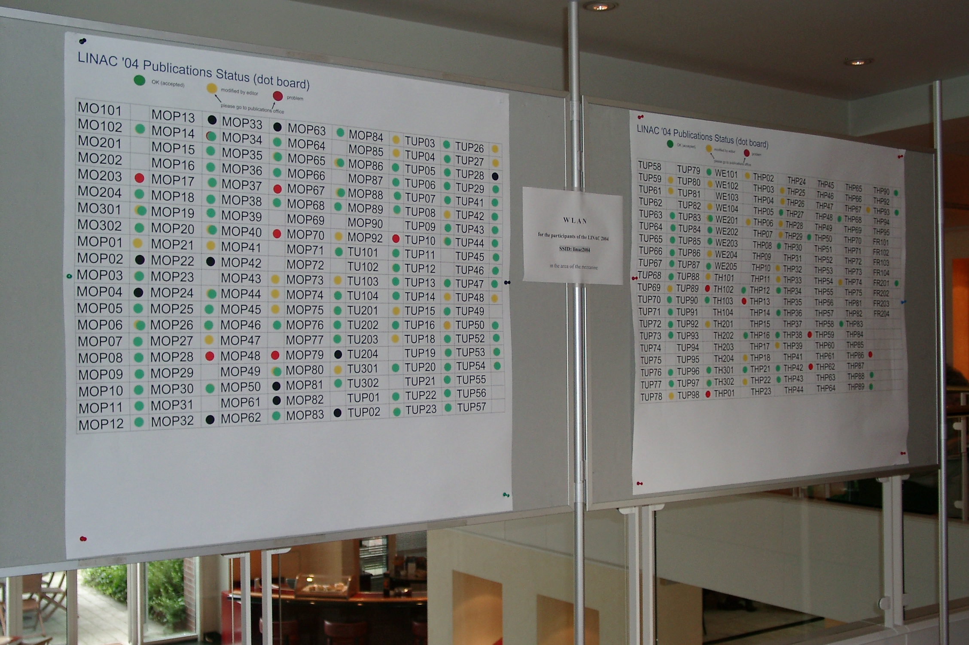
Dotting Board at LINAC’04

Slide 5
Overview
What kind of changes took place will be shown based on data of the last 10 years (where available) for
preferred platforms for file types,
accuracy of submissions, and
changes in file type for conferences

Slide 6
Changes
Changes in
preferred platforms for file types

Slide 7
Preferred platforms for Word

Slide 8
Preferred platforms for T_{E}X

Slide 9
Preferred platforms for ODF

Slide 10
Changes
Changes in
accuracy of submissions

Slide 11
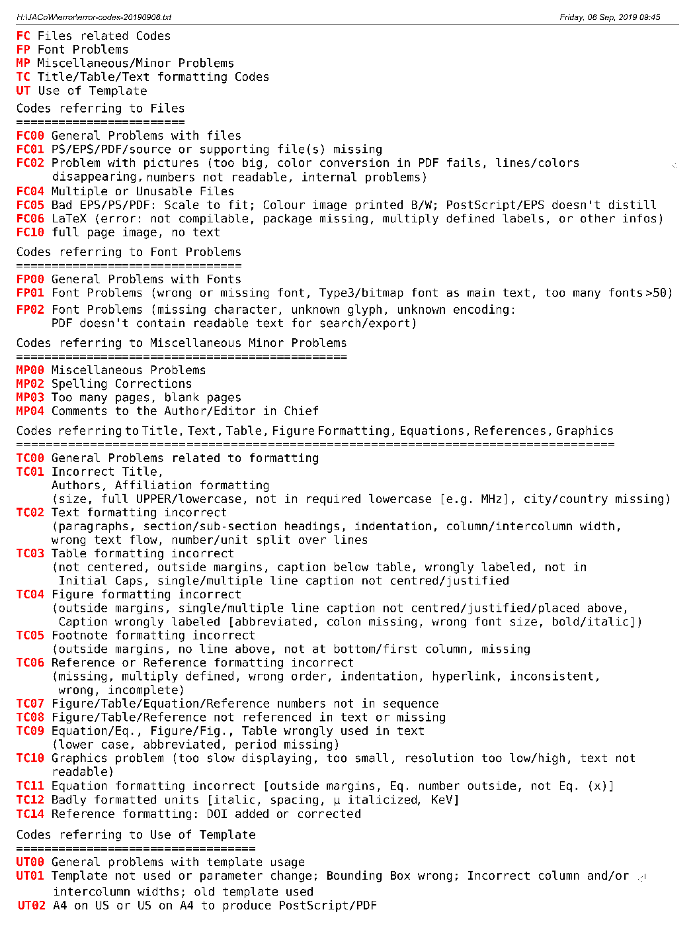
Accuracy of submissions
JACoW maintains a list of Error Codes which is updated when the need arises

Slide 12
Accuracy of submissions

Slide 13
Changes
Changes in
file types for conferences

Slide 14
Changes in file type in IPAC

Slide 15
Changes in file type for ICALEPCS

Slide 16
Changes in file type for FEL

Slide 17
Changes in file type for IBIC

Slide 18
Changes in file type for SRF

Slide 19
Changes in file type for LINAC

Slide 20
Changes in file type for Cyclotrons

Slide 21
Changes in file type for HB

Slide 22
Changes in file type for ECRIS

Slide 23
Changes in file type for COOL

Slide 24
Changes in file type for PCaPAC

Slide 25
Changes in file type for LINAC

Slide 26
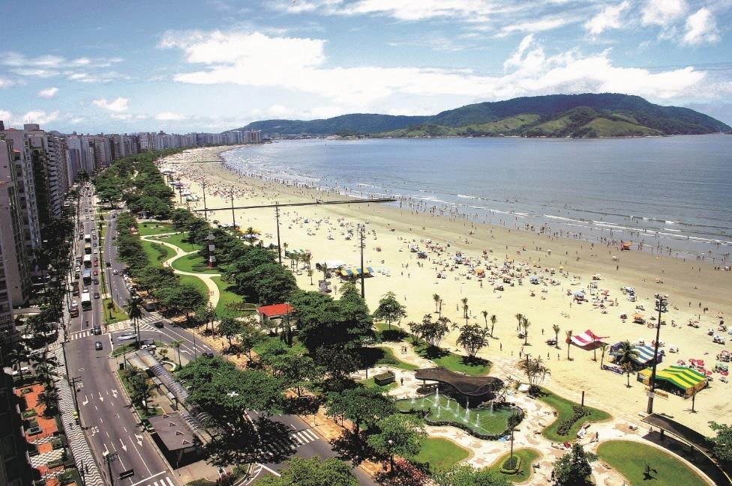
Questions?

