Slide 1
IPAC Light Peer Review
IPAC’19 was third year of IPAC light peer review
History
Started at Copenhagen IPAC’17 by Ralph Assmann et al.
A community effort to raise number of citations to, and overall impact factor of, PRAB
Educate and engage student community to get them used to peer review activities
Carried on through IPAC’18 and IPAC’19
Published in IOP conference series journal
Alex Bogacz (JLab) led effort at IPAC’18/IPAC’19
Role as APS DPB publication committee chair in 2018
Peter McIntosh training for this role at IPAC’20

Slide 2
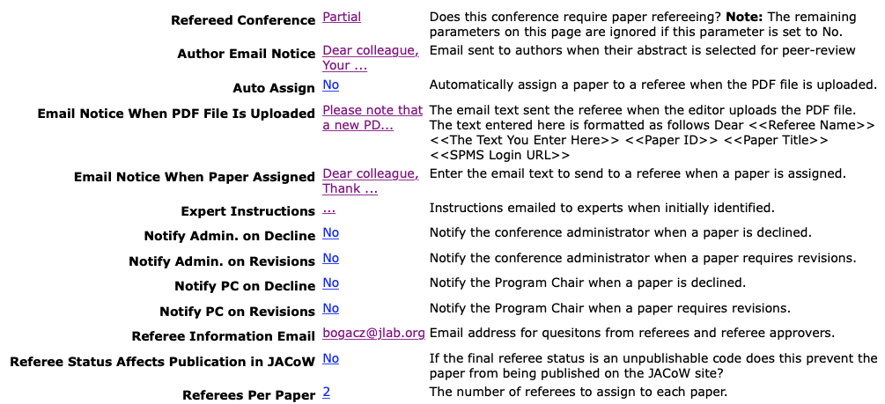
Light Peer Review Process: SPMS Setup
Initiated by SPC chair, implemented by Secretariat
Identify separate light peer review coordinator
Will have a big job for ~2 weeks before conference
IPAC: 2 referees per paper, “partial” refereeing
Accessible through System Parameters / Experts/Referees

Slide 3
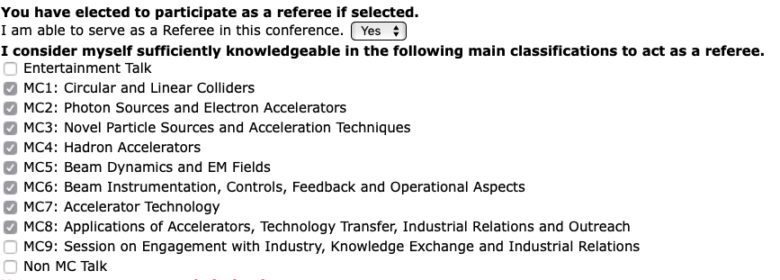
Light Peer Review Process: Abstract Submission
Author self-identification of submitted abstracts
Abstract submission button to indicate interest
First-come, first-served up to SPC-defined limit
Author and registrant reviewer volunteerism
Prominent on SPMS front page (jacow.html) after login
Volunteer by MC, but no further granularity
No identified requirements (e.g. 2+ years after PhD?)
Some confusion that registration is requirement to serve

Slide 4
Light Peer Review Process: SPC
Selection of reviewers
SPC MC coordinators for each individual MC
After abstract submission deadline, reclassification
Usually initiated at SPC3 meeting
Know or are aware of nearly all relevant volunteers
Some MCs may need more granularity (e.g. MC7)
Accessible through Referee Module: List Referees by Main Classificaiton

Slide 5
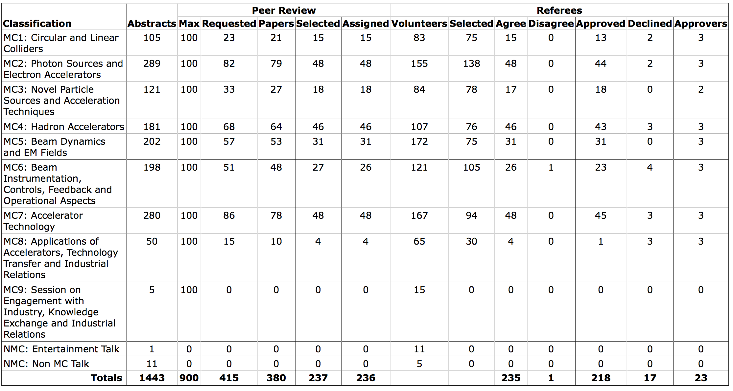
IPAC’19 “Scoreboard”
218 / 237 papers accepted for light peer review volume
More than enough reviewer volunteers

Slide 6
Light Peer Review Process: Review Timeline
Relative to nominal IPAC paper submission deadline
-14d Light peer review paper submission deadline
-5d Referee initial report deadline
3d for authors to revise papers (tight but “do-able”)
-2d Author revision submission deadline
Author revisions done before JACoW processing
Regular conference paper submission deadline
+2d Referee final publication status decision deadline
+2d Authors informed of final LPR publication status
+7d LPR coordinator decision deadline for conflicts
+18d Reformatted IOP paper template deadline
Many actions, decisions, communications happen in two weeks around paper submission deadline

Slide 7
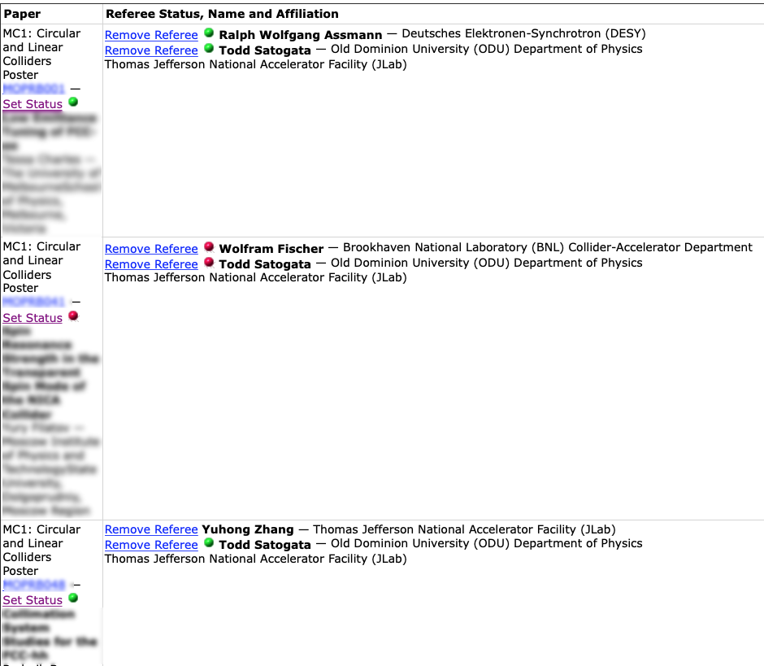
Referee Status Page
Red: Rejected (before or after revision)
Yellow: Revisions required
Green: Accepted for light peer review publication
Editor/SPC intervention required if:
- Red/Green (“Christmas lights”)
- Reviewer unresponsive by deadline

Slide 8
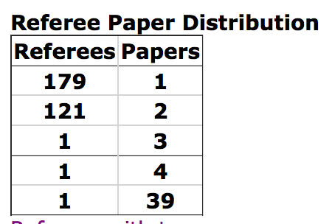
Referee Participation
Timescale is highly compressed
A real impact if referees or authors are not prompt
Large portions of process can end up on shoulders of a few
Can create collisions with editorial/JACoW process
Verify availability before assigning to papers for IPAC’20
Hope to streamline process, focus on scientific quality

Slide 9
IPAC’17-IPAC’19 Statistics
 | IPAC17 | IPAC18 | IPAC19
Total conf participants | 1350 | 1276 | 1008
Total papers submitted | 1426 | 1502 | 1215
Total peer review submitted | 123 | 190 | 237
Number of referee volunteers | 387 | 495 | 421
Total peer review accepted | 110 | 177 | 218
We have approximately hit target levels of submission
18% of IPAC’19 papers accepted for light peer review
We are starting to see signal!
PRAB impact factor notably higher in 2019: ~1.7
Please make sure your LPR papers reference the last two years of PRAB articles and spread the word

