Slide 1
Editing Tips and Tricks Using MS Word and PitStop 2019 Team Meeting Santos, Brazil

Slide 2
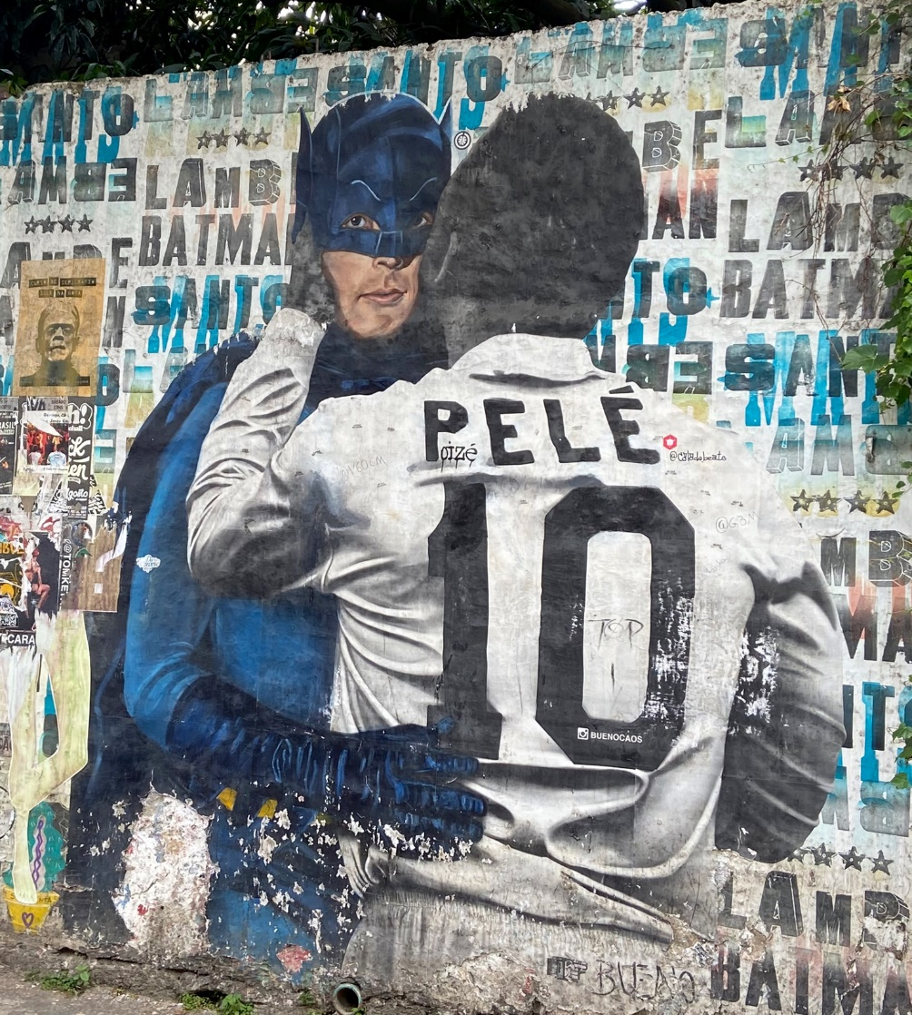
It isn’t as bad as you think it is
Batman Alley Nov 2019

Slide 3
What you have learned so far:
It is very important that the settings for MSWord, Acrobat and PitStop conform to JACoW settings;
All the machines in the room have the same settings;
For small conferences you may need to configure your machine assigned to you.

Slide 4
IPAC’17 Common Mistakes

Slide 5
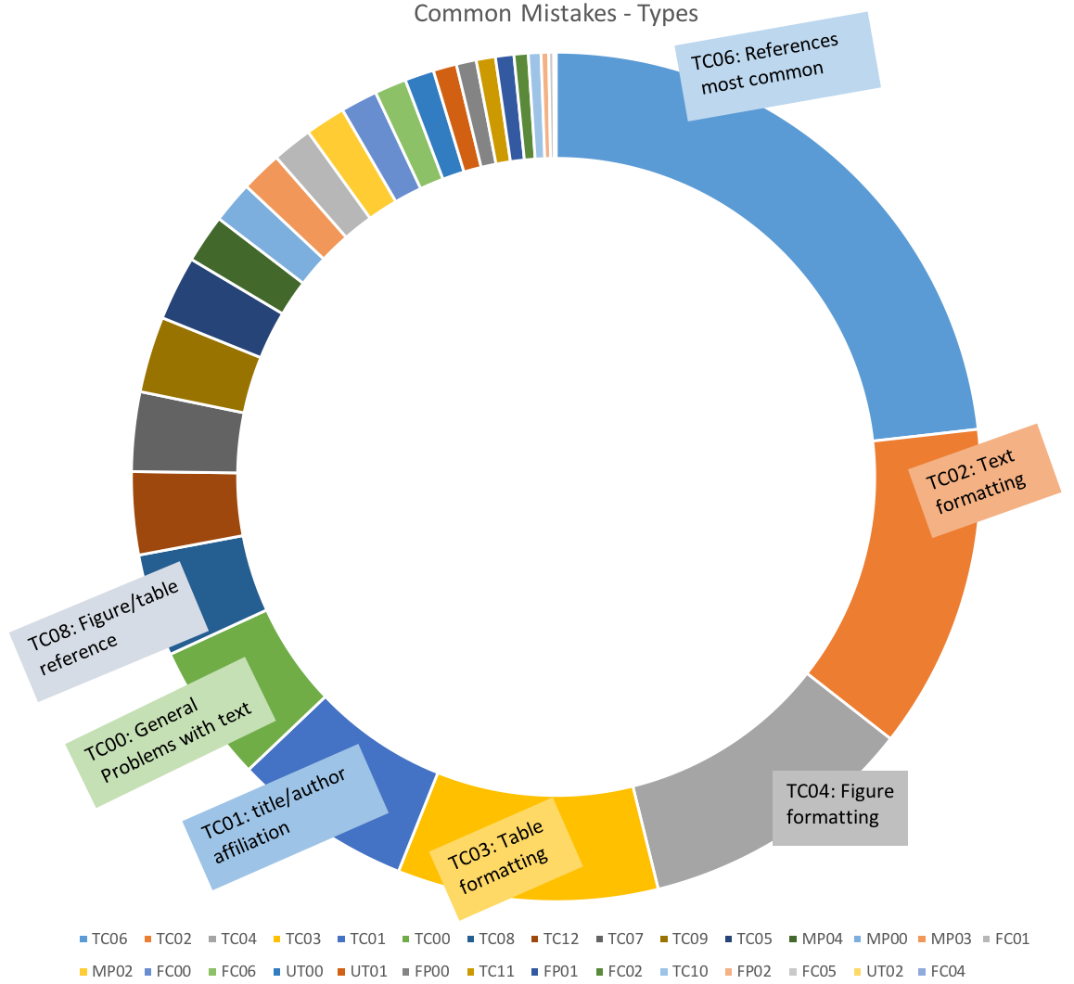
IPAC’19 Common Mistakes
anomaly

Slide 6
GROUND RULES
Level 0: non-negotiable (see: http://www.jacow.org/Editors/BasicPaperProcessingProcedure)
Paper size – (JACoW specific – prints equally well on A4 and US Letter); evident when you apply the JACoW Media box on the document. You will see a large empty space above the title if they have used US Letter settings on A4 template.
Page layout – text prints within the the media box. Sufficient room has been left for the scripts (each page carries the conference name and a page number for final production etc.);
Figures and equations fit within the media box
Footnote does not print below the left column
Footnote is below the left column, and single-column width
Formatting –
Title: 14 pt, centred, Times New Roman, Bold, ALL caps except units, symbols, anonyms (i.e. MeV)
Author list: 12 pt, centred, upper/lower case, has affiliation and location

Slide 7
Level 0: non-negotiable
Footnotes: 8pt, located in a text box below first column on the first page, footnote line above. * for Title = (funding agencies), Author† for the email address. If no funding footnote, then footnote to author is an asterix. Note: footnote symbol order of use: * † ‡ § | ¶
Section/subsection/subsubsection Headings:
Section: Bold, all uppercase, centred, 12 pt (except units i.e. MeV) Subsection: left justified, 12pt, upper/lower case, italic; Prepositions no capital (i.e. from, in, due to)
Subsubsection: bold, left justified, 10pt (matches text) and is part of the paragraph
Body of the paper (text): Times New Roman, 10 pt, two column follows JACoW Template

Slide 8
Level 0: non-negotiable
Figures & Tables must be mentioned in the text.
Figures: in consecutive order (Fig. 1, Fig. 2…. Not Fig. 1 then mention Fig. 5 and then Fig. 2), arabic numbers, not roman
Tables in consecutive order
Table caption is ABOVE the table
Figure caption is BELOW the Figure
Figure Caption has Figure written out and has a colon, and finishes with a period (i.e. Figure 1: Words, wordy, word.)
Table Caption is written in full and does not finish with a period (i.e. Table 1: Words, wordy, word)
References
Square brackets, in consecutive order
None missing
In consecutive order
All information is there to find the citation (tool: https://ref.ipac19.org)
No hyperlinks in references
Use of <9 references and >9 references style from JACoW styles

Slide 9
Level 0: non-negotiable
Equations
If numbered, must be uniquely numbered in consecutive order; not printing into margin
Top of columns match

Slide 10
Let’s get started
Which software should you use to correct this paper you downloaded?
Acrobat or Pitstop?
Or go to the source Word/LATeX?
Should you use CatScan first?
Should you use CatScan after you edit?
CatScan: http://edit.ipac19.org/upload

Slide 11
Which software ?
MS Word – lots of corrections
Acrobat – minor fixes
PitStop – minor fixes

Slide 12
Minor edits:
File type: PDF
Software tool: Acrobat or PitStop
What to correct:
Headings / Subheadings: i.e. font case upper or lower case
Column is too long for the page and needs to be nudged up
Footnote is below the media box
Figure or table prints into the column
Figure needs to be replaced because it renders too slow
Hyperlink in references
Figure caption begins with Fig. x: rather than Figure x:
Figure caption has no period
Table caption has a period
Captions are not in the correct spot (error: above for a figure, below for a table)

Slide 13
Pitstop editing
Hyperlink:
Use PitStop selection tool to select the ‘line’ UNDER the line, and delete it.
Open the Pitstop Inspector (Ctrl+Alt+I)
Select the whole text that you want to change
Select the Fill and Stroke tab
Convert the text to grayscale
Set it to 0% Brightness

Slide 14
There is usually more wrong than the oversized graphic. i.e. Fig x. rather than Figure x: and centred for multi-line or left justified for a single-line caption. If the over-sized graphic is the only error, use PitStop.
Outside the margin
Outside Margin
Indented

Slide 15
Pitstop editing
Subsection heading, only first word is uppercase and you need to uppercase the other words.
Use the PitStop selection tool and select what you want to change from lower case to upper case
Open the inspector (Ctrl+Alt+I)
Press on the “select font” button from the menu (the small one with the two letters on it)
Select the font you want to use for the text (TimesNewRoman PSMT True Type), if italics or bold choose the applicable font choice
Check the “Embed font” box so that your font is embedded into the document
Press apply to finish your changes.
You may need to repeat this process with each change you make to the text. Failure to change the font using Inspector will result in an error message.

Slide 16
Something is wrong! (if you are only working with Word files, pre-QA, you would only see this problem at QA)
You used Inspector. But there is still a font substitution to your text and you can’t seem to fix it.
This is a LATeX file.
Solution:
If you know LATeX fix at source
If you are not a LATeX user, send back to the original editor.

Slide 17
Pitstop editing
Scaling text:
How to fix a Figure or table that prints into the margin
Use the PitStop selection tool and select what you want to scale
Open the inspector (Ctrl+Alt+I) and the Position tab
Put 99% into the scaling field. Each time you press the button the selection is downscaled to 99% of its size
Make sure that the final font size is not too small (~9pt is acceptable)
An optional method is to drag the corner of the item until it fits the column, ensure the font size is acceptable.

Slide 18
Pitstop editing
Nudging a column:
Using your selection tool click on the column, then select the “move tool”. Use your arrow key to move the text up.

Slide 19
Pitstop editing
Missing footnote line
Select the footnote line from the JACoW template
CTRL + C …. CTRL+V to your document.

Slide 20
Go to the source when there are a lot of edits to the text
JACoW Template:
You find that the JACoW Template is not in your document:
Templates and Add-ins - (.dot file is found in Editor or Template location on directory, if not there, you may need to download)
Attach: JACoW_W10_A4.dot or letter to your document,
Be sure to Click “Automatically update document styles” otherwise you will not see the JACoW styles to choose.

Slide 21
Formatting – use the JACoW Styles It will make editing easier
The template comes with JACoW required styles as displayed on the Home Ribbon
Style | Font | Space Before | Space After
PAPER TITLE | 14 pt UPPERCASE EXCEPT FOR REQUIRED lowercase letters Bold | 0 pt | 3 pt
Author List | 12 pt UPPER- and lowercase | 9 pt | 12 pt
Abstract Title | 12 pt Initial Caps Italic | 0 pt | 3 pt
SECTION HEADING | 12 pt UPPERCASE Bold | 9 pt | 3 pt
Subsection Heading | 12 pt Initial Caps Italic | 6 pt | 3 pt
Third-level Heading | 10 pt Initial Caps Bold | 6 pt | 0 pt
Figure Caption | 10 pt | 3 pt | ≥3 pt
Table Caption | 10 pt | ≥3 pt | 3 pt
Equation | 10 pt base font | 12 pt | 12 pt
References¹ when ≤ 9 | 9 pt, justified with 0.52 cm (0.2 in) hanging indent | 0 pt | 3 pt

Slide 22
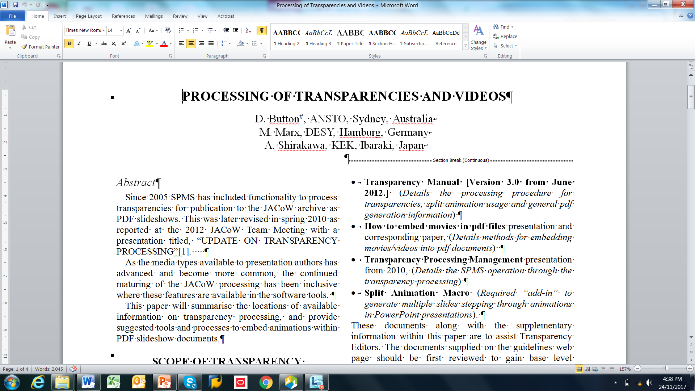
Turn on hidden symbols
Paragraph symbol
Displays non-visual text layout and punctuation characters as symbols
Can give editor clues as to what the author has done during construction of their document, can however flow your view.

Slide 23
Show Text Boundaries
Text Boundary
Shows the boundaries to which sections of text can exist within
Good for giving simple clues to the layout problem in document

Slide 24
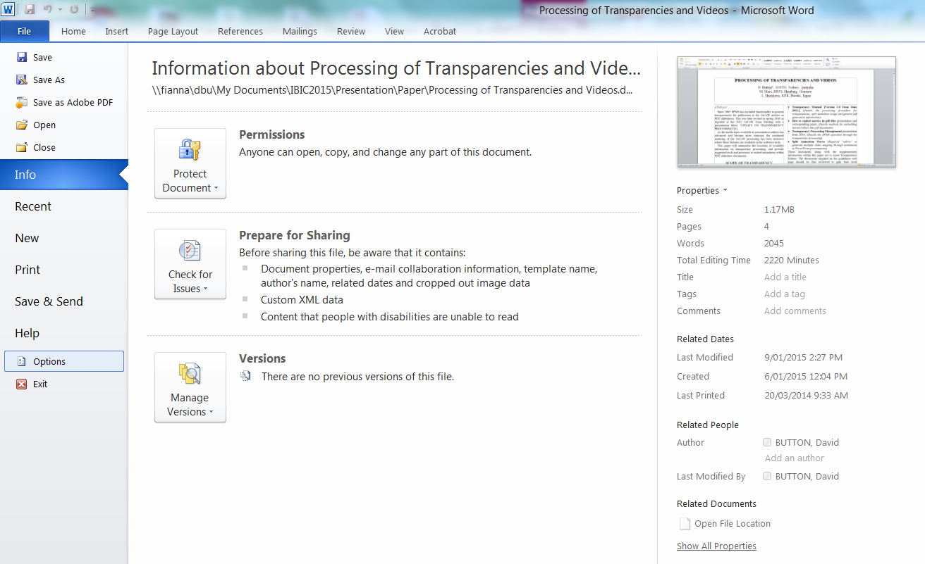
Show Text Boundaries
How to Turn On Text Boundaries
1
3
Scroll
Down
2
4
File > Options > Advanced > (Check) Show Text Boundaries

Slide 25
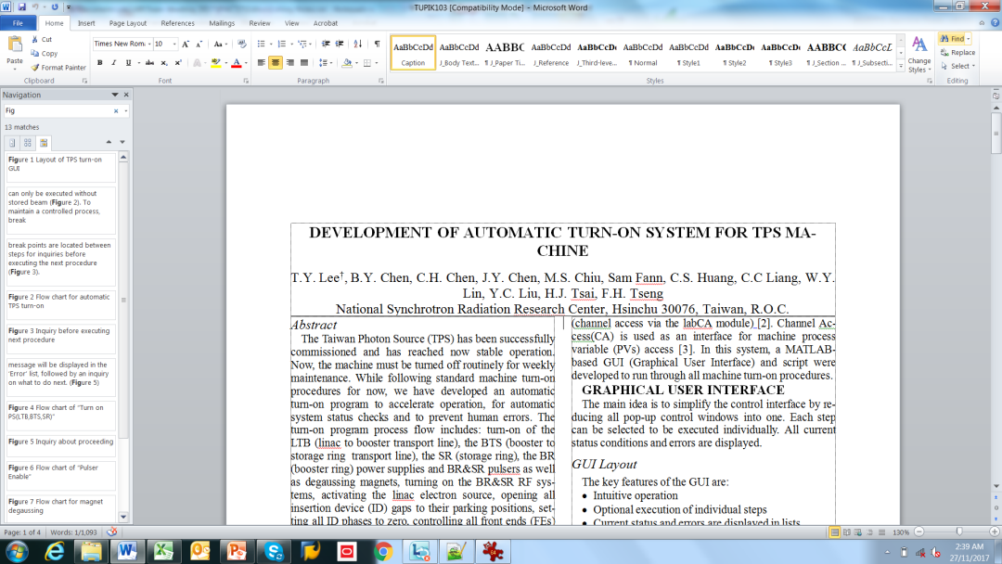
Search’s Find (ctrl – f)
The find tool can be use to locate existence of in text references such as;
Figure references (search for “fig.”)
Sighting of reference in text (search for “[”)
Table references (search for “table”)
Etc.
Home Ribbon

Slide 26
Search’s Replace (ctrl – h)
Find What: “Fig.”
Replace With: “Figure”
Can iterate through document, and replace appropriate as “Found” in sequence, only replace the ones required.
More accurate than scanning and replacing by eye…
Note: Do Not use “Replace All”

Slide 27
Formatting Styles
The template comes with JACoW required styles as displayed on the Home Ribbon
Right Click
If “Automatically update” is checked then every time you modify the justification of one caption, it will change for every caption in the document of that type. Un-Check if Checked.

Slide 28
Fudging space - David’s way Fudging Line Spacing (Shift + Ctrl + “<“ OR “>”)
In Pitstop the editor will use the move tools to improve the layout and distribution of text. You can use a small trick to do this in word. This is done by increasing or decreasing the font size on a line.
1. Select Blank Line
2. Use Shift + Ctrl AND “<“ or “>”

Slide 29
Fudging space – Jana’s way Fudging Line Spacing: (paragraph spacing). You can put in the pt amount you want to move down
1. Insert cursor, right click or choose paragraph from menu bar.
2. Put in the points you want increased above or below. (for headings JACoW style is pre-defined, correct points when the heading or subheading is at the top of a column to align the tops of the columns)
This is very useful when you have moved text around and the Heading is 12pts below the top of the page, meaning the columns are now uneven at the top.

Slide 30
Formatting Format Painter Tool
Highlight the text which is formatted the way you want to copy.
With the select brush paint the text you want to have the same formatting.

Slide 31
Formatting Figure and or Table captions
Highlight the figure caption or table caption text.
Choose from style menu the appropriate text style (i.e Figure caption multi-line (left/right justified); Figure caption single-line (centred). The correct amount of points will be put in above and below the caption pre-defined in the JACoW style.

Slide 32
Visualisation – Document Outline
Flattens document into linear sequence
Good for finding tricky formatting issue in the document, elements which have moved outside of workable view.

Slide 33
Formatting - Figures Inline with text
Documents which have figures or objects which are not in-line with text are highly unstable and almost impossible to edit without document layout changing unpredictably.
Another “feature” you might experience is a figure put into a table environment, or as a text box. This complicates formatting un-necessarily.
You will recognize this type of ‘author’ formatting by the figure caption being centered within the boundaries of the figure, not the text boundaries.
You need to place the figures/objects inline with text, or top/bottom, and re-format.
Author has constructed figure in a text box
with text wrapped around the shape.
(To Get Menu: Select Shape/Object, Right Click)

Slide 34
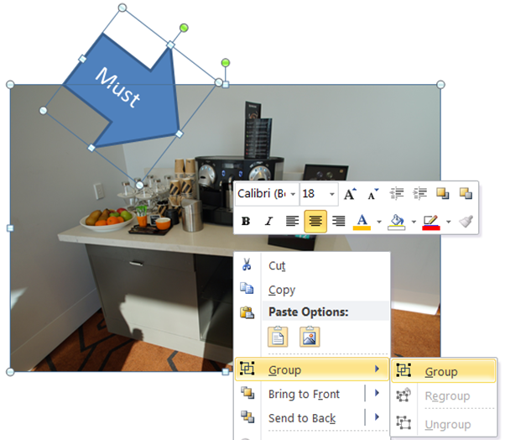
Formatting Inline with text -Grouping
Objects to Group
Can now be place inline with text
group
Note: You may have to use the “Group” tool if the figure is made up of a number of objects.
Select all of the items, and choose “group”. This will flatten/group as one object.

Slide 35
Formatting Removing Hyperlinks (ctrl + k)
The final PDF JACoW format document should not have any hyper links. To remove hyperlinks in the word document use the “Ctrl + K” Edit Hyperlink menu, click “Remove Link”.
www.jacow.org

Slide 36
Formatting – break tips
Paragraph Break New Line | Enter | Standard carriage return
Line Break | Shift + Enter | Soft return, goes to next line without new paragraph. Very useful for Headings, subhedings and the title
Page Break | Crtl + Enter | Starts text on next page
Column Break | Ctrl + Shift + Enter | Starts text in top next column
Section Break (Continues Break) | Page Layout Page Setup Breaks | Used when changing from column sections
Non-break hyphen | Ctrl/shift + - | Keep hyphenated word together
Non-breaking space | Ctrl/shift + space bar | Use to keep units together with number. Initials together with last name

Slide 37
Editing at PDF level – Acrobat or PitStop only
Editors Time costs and is a Premium!!!
Extensive editing using PitStop or Acrobat has its Pitfalls:
at QA more corrections are found and either the original editor or QA editor need to fix more errors
when the final script is run on the body of papers and errors are found, more often than not the Editor-in-Chief needs to go back to the source and re-do the paper and generate a new PDF.
Either of these scenarios cost time and money to the conference

Slide 38
Mixed bag of editing:
References: when you remove the hyperlink
Font: Lucida Sans Typewriter font size 8pt, or use the JACoW style references defined style for URLs.
Footnote marker tip/trick: order of use: * † ‡ § | ¶
Windows MSWord: ALT + 0134 will give you a single dagger
Mac MSWord: option + t for dagger †
Windows MSWord: ALT + 0135 will give you a double dagger
Right click + paragraph: change point size to cinch up text on a page
Acrobat:
Shift + Ctrl + F = advance find (to search for Fig. / Ref. / Table / [
Ctrl + D = Check fonts
Thank You

Slide 39
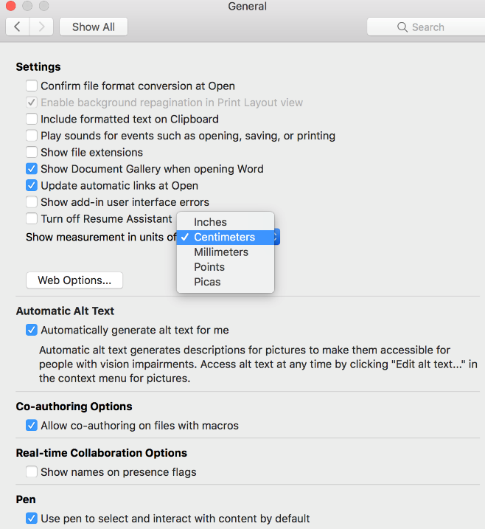
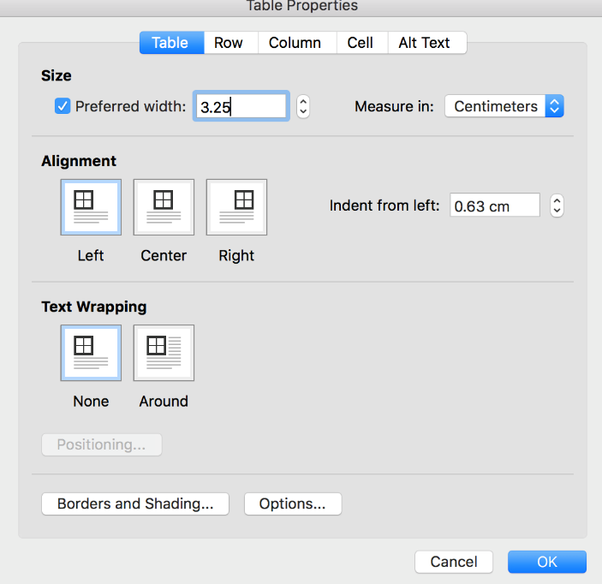
A Table is 3.25 cm wide = fix this by going into table properties. Ensure your units are in centimeters (in preferences for Word). Change the table if needed to be “preferred width 3.25 cm”. If they have put a figure within a table, you need to play with this.

Slide 40
References: et al. in italics. 1 author et al. no comma more then one author then et al., comma after.

