Slide 1

Revision of 2016 Meeting Information & Notes for this Years JACoW Team Meeting
David Button
JACoW BoD
Australian Nuclear Science & Technology Organisation

Slide 2

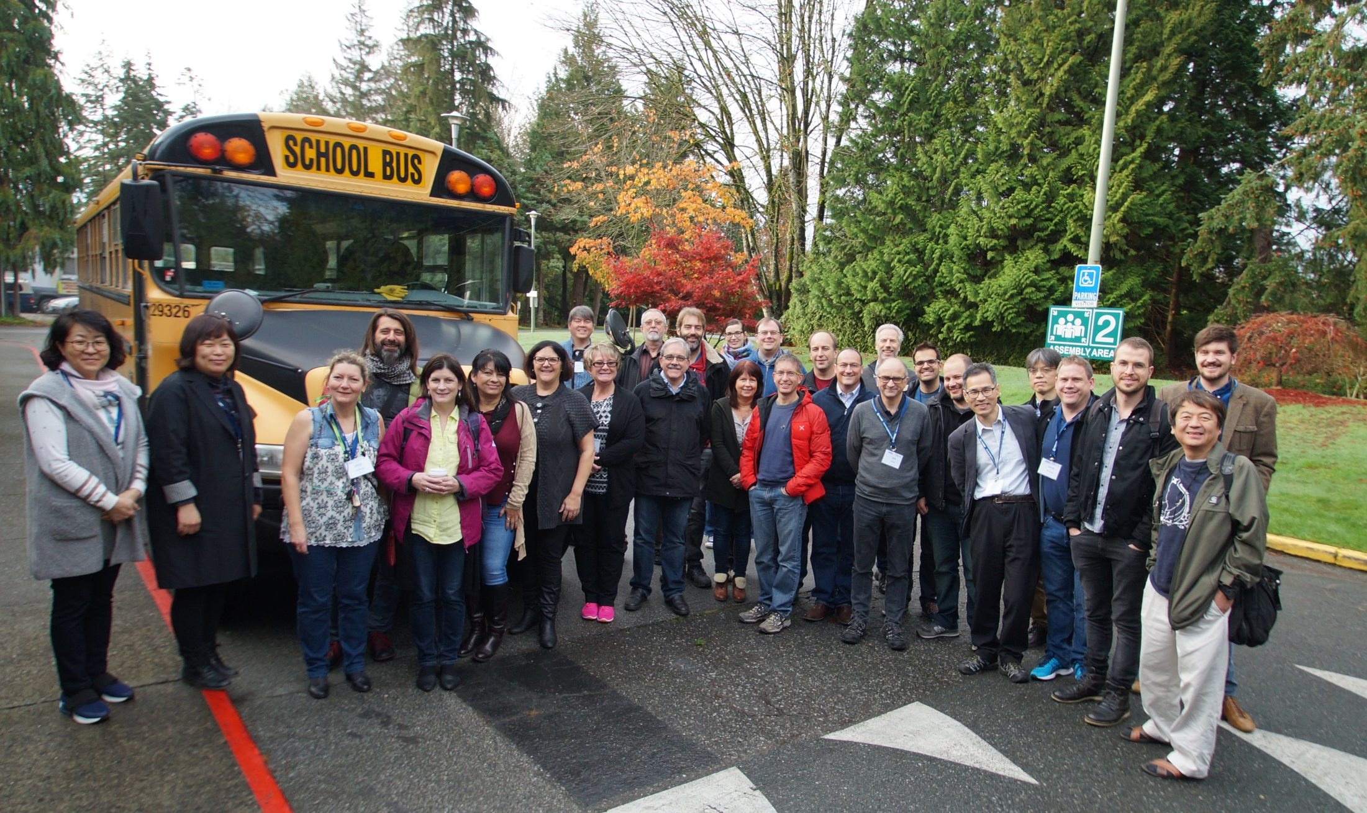
JACoW Team Meeting 2016
TRIUMF Vancouver Canada
35

Slide 3

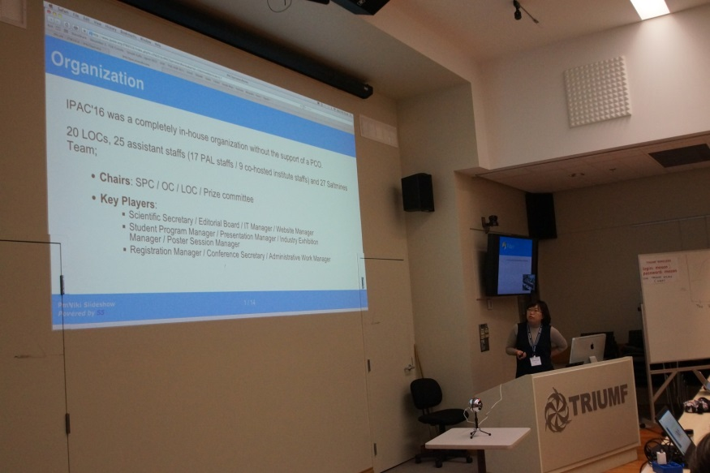
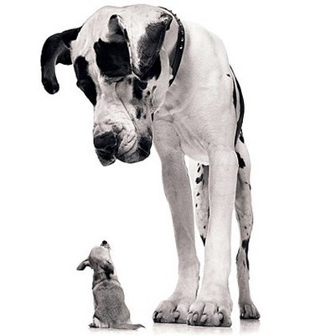
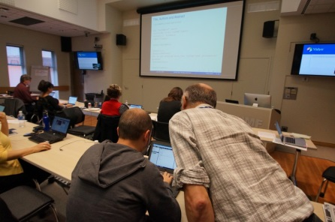
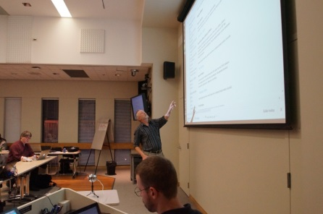
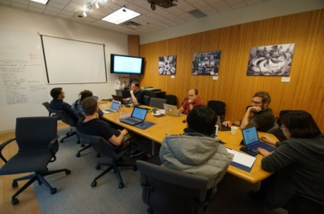

Revising the Wiki
  Presentations in the Wiki
Balancing Large and Small Conferences
Something for new and Advanced Team Members
Train Editors/Team Members
Produce collection of conference details
Indico introduction
LaTeX Bootcamp
Scripting
Paper Processing

Slide 4
Last Year Presenters
Local Host Jana Thomson and TRIUMF
Presenters, Tutors, Work Group
Jana Thomson | Maria Power | Juliana Pranke | Sue Waller
Ivan Andrian | Pedro Ferreira | Jan Chrin | Vicent Mitts
Ronny Billen | Volker Schaa | Kyung Sook Kim | Dong En Kim
Todd Satogata | Charlie Horak | David Button | Raphael Mueller
Johan Olander | Stefano Deiuri | Garry Trahern | 19
Indico Development Team

Slide 5

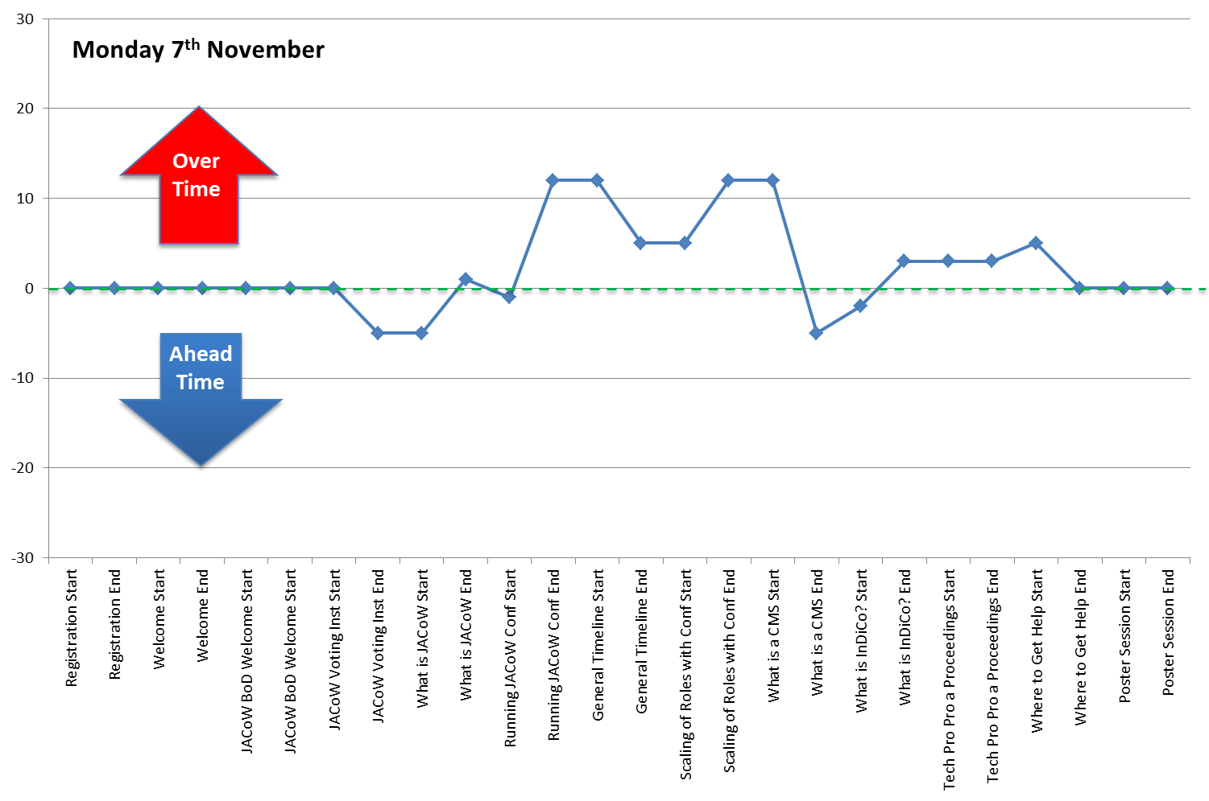
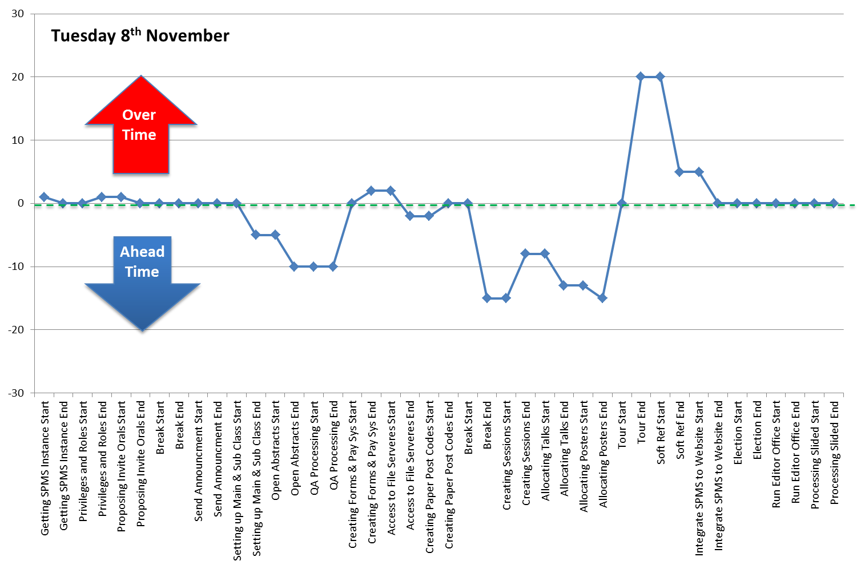
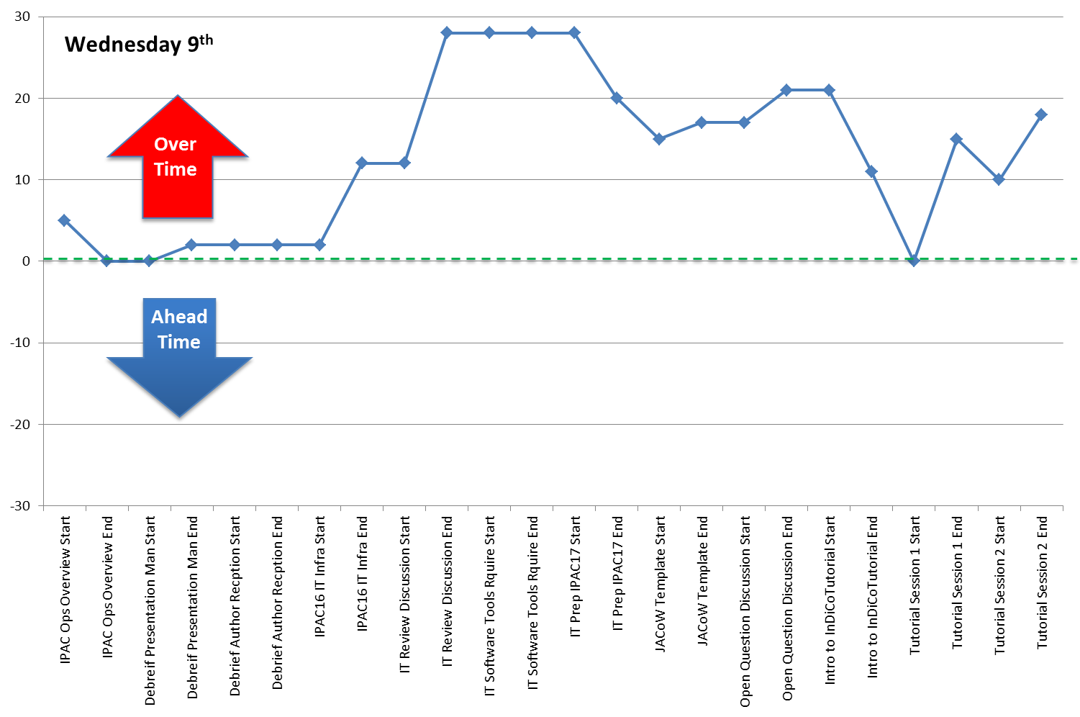
Last Year Feedback

Slide 6
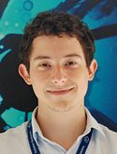





Last Year Feedback
Responsible AV, or presentation person.
Host needs shadow to allow themselves time to participate more.
Communication, respectful response to organisers emails and requests. (All Guilty)
  3 posters confirmed
  Email exchange time
Odd year of conferences, not as many new editors.

Slide 7
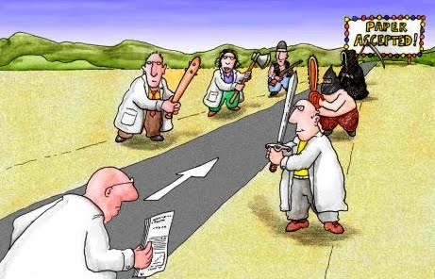





New for this Meeting
How to work with the wiki
Refereeing in SPMS recent experiences
Indico Latest developments
Collaborative organisation tools
Updates, Templates, Editing, Transparency Conversion, Mobile App, etc.
IPAC’17 Experiences, lessons learned
Past, Present, and Future JACoW Conferences

Slide 8

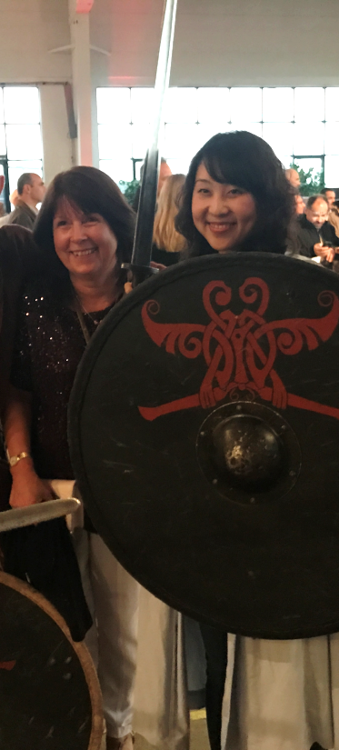
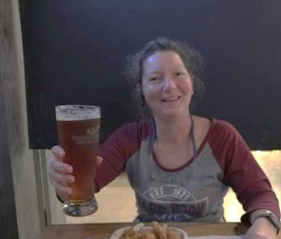
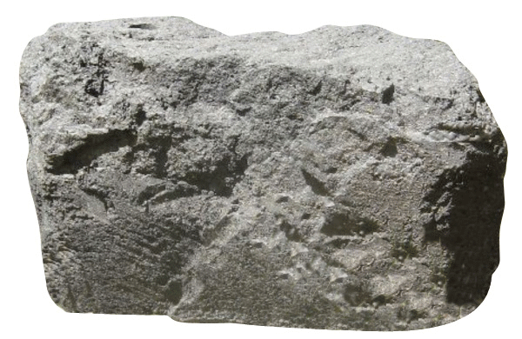

Big Thank You
Prof Qing Qin Deputy Director of IHEP
LOC Hosts & Organising Committee
Speakers and Tutors
Rapporteur (Jana)
Poster Presenters
“Volunteered” Session Chairs
Indico Team
Institutes & JACoW Team Members
Ning Zhao
Warrior

Slide 9

Final Notes
Session Chairs please note down and summarise all questions and points of discussion to pass them onto to Jana our Rapporteur.
Feedback, please feel free to approach myself or others to discuss what worked, what could be changed, and what is missing throughout the meeting. Please pass your comments onto myself for inclusion in the final session.
Everyone will be walking back to the hotel this afternoon, and we are all walking between IHEP and the hotel with exception of the evening of the dinner.

Slide 10
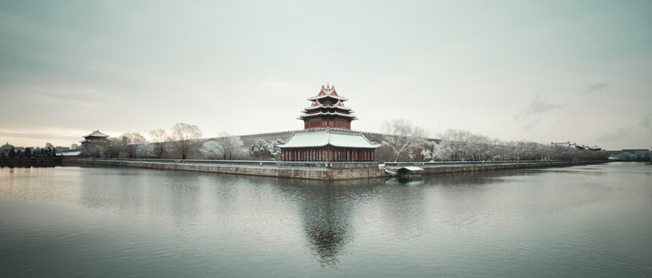
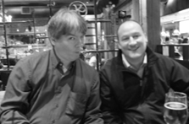

谢谢
Xièxiè (Thank You!)
Please have a productive and enjoyable meeting ahead!
KEEP
TODDLING

