Slide 1
IPAC’19 – Melbourne IT Preparation
Mark Caetano (mark@ansto.gov.au)
Mitchell Hewes (mitchell@ansto.gov.au)
Information and Digital Services – ANSTO, Lucas Heights, Australia
Presented by Johan Olander (ESS)

Slide 2
Overview
Aim of the game
Standard Hardware Environment
Software distribution and configuration
Networking/Connectivity
Speaker Prep/Presentation
Editorial Room Setup

Slide 3
Apologies!
Firstly –
I would like to extend my apologies for not being able to make it to the team meeting.
We’d also extend our thanks to Mr. Johan for stepping in to give this presentation on our behalf.
Tack så mycket!

Slide 4
Aim of The Game
I.T. is the backbone of the conference.
It should support and enable the delegates, staff, editors and attendees, without being a hindrance
Provide a full environment that is ready for all users to simply turn up and begin working.
Provide all I.T and technology facilities required at the conference
Deploy an environment that is stable, seamless and contributes to the overall success of IPAC’19

Slide 5
Standard Hardware Environment
Fit for purpose desktops for editorial room and paper lounge:
Business-grade HP Elite Desk 800 G3
6th Gen i7 CPU
16GB RAM
Dedicated graphics
HDD upgraded to 250GB Solid State drives
Equality: GIANT-ASS 27” 4K Displays for all! (no more grainy postage-stamps)

Slide 6
Standard Hardware Environment
For those of us who like decaf soy latte’s
HUGE-ASS 27” Apple iMacs
512GB SSD + 1TB Fusion Drive
4+1K Retina Displays to make poorly-formatted papers super crisp
Dedicated graphics
No – I refuse to dual-boot these, Johan. Please direct all complaints to mark@ansto.gov.au

Slide 7
Standard Hardware Environment
Additional support hardware?:
75” displays on stands for dotting boards and signage
Floating pool of i7 Notebooks and MacBook Pro’s
6x iPads for Poster Police (BYOD does not work)
12x two-way radios for organisers, etc
On-site file server for backups/software
27” 4K display for Volker
Beer fridge
Oh, and some printers…

Slide 8
Hardware Distribution
Editorial Office: 23x HP Desktops, 3x iMacs, 3x printers
Author Reception: 2x HP Desktops
Speaker Ready: 2x i7 Laptops, 2x MacBook Pros
Net Café/Paper Lounge: 3x HP Desktops, 3x iMacs, 1x printer
Hot spares: 3x HP Desktops, 3x i7 Laptops, 3x MacBooks
Displays: 2x dotting boards, 1x editorial stats
File Server: 1x HP Xeon Workstation

Slide 9
Standard Software Environment
Largely mirrors the IPAC18 software list
Windows 10 Enterprise x64
Office 2016 Professional x86
LibreOffice 6.x
Acrobat Professional DC
With JACoW config and options in Distiller
PitStop Pro 2017 (Trial)
With JACoW actions (mediabox etc)
Notepad++ and SublimeText
IE11, Edge, Chrome, Firefox
7ZIP, UniExtract
IrfranView, GIMP, Paint.NET
Handbrake, VLC, VirtualDub, K-Lite Codecs

Slide 10
Standard Software Environment
Oh, we nearly forgot!
MikTex
TeXStudio
Texmaker

Slide 11
Software Distribution
Moving away from cloning a fully-built image and towards a base system image and post-flight configuration process:
Image base system with Windows 10 and drivers from a TFTP server on-site (Clonezilla - 30 mins per machine)
Deploy base software through a package manager (chocolatey, NiNite Pro)
Customise software and environment to JACoW standard, depending on system’s use (PowerShell Scripts)
QA and test all machines

Slide 12
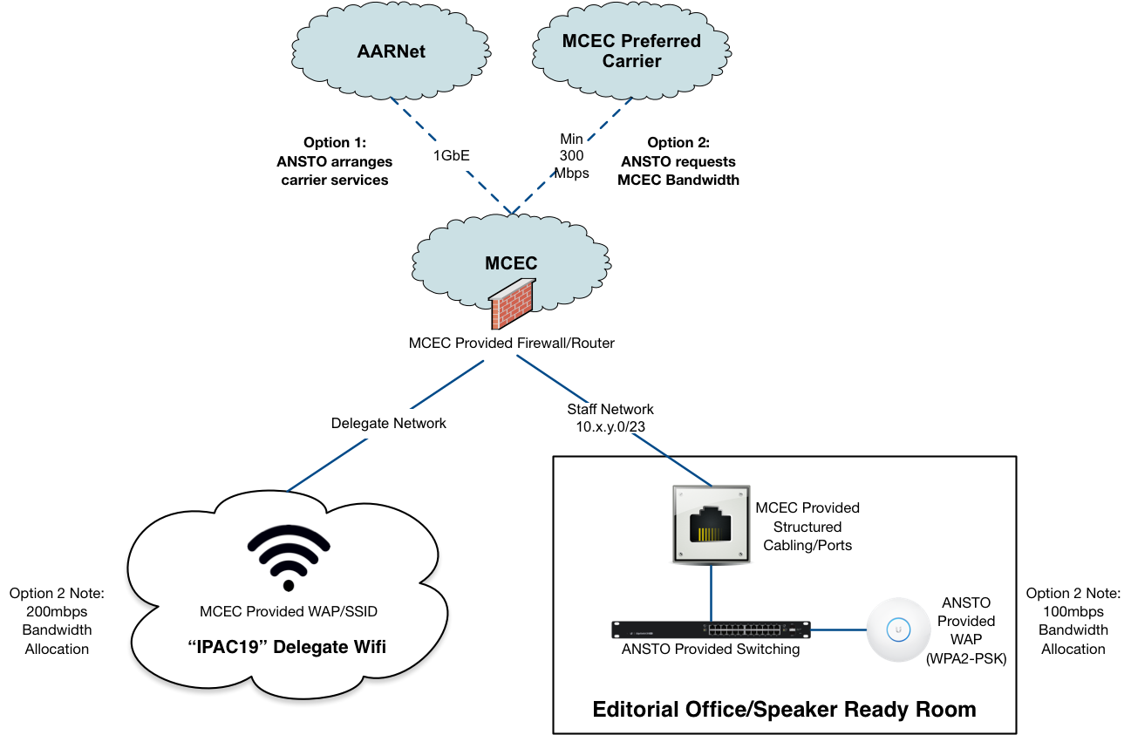
Network Overview
ANSTO Supplying NREN (AARNET) bandwidth to venue’s border router
Delegate network via MCEC wireless network
Editorial/Staff network via ANSTO-supplied BYO hardware

Slide 13
NREN for Internet Connectivity
Typically venue connectivity is split into two categories:
Expensive Upstream Connectivity to the Internet
Cheap Internal Connectivity within the venue
Most countries have a National Research and Education Network e.g. GEANT, RENATER, or Australia’s AARNet
Lab upstream connectivity is usually provided by NREN
= Existing relationship
We looked at two options for connectivity
100% Venue provided
Venue provided internal connectivity with NREN provided internet connectivity

Slide 14
Approximate Cost Savings
Item | Option 1 (Venue) | Option 2 (Venue + NREN)
Internal Connectivity (Always Venue) | $5,600 | $5,600
Internet Connectivity | $40,000 / per 200gb / at 100mbps | $0 (In-Kind Sponsorship) / Unlimited Usage / at 1gbps+
Our NREN already had a fibre optic connection to the venue so there were no associated capital costs
Approach them! You never know… ☺

Slide 15
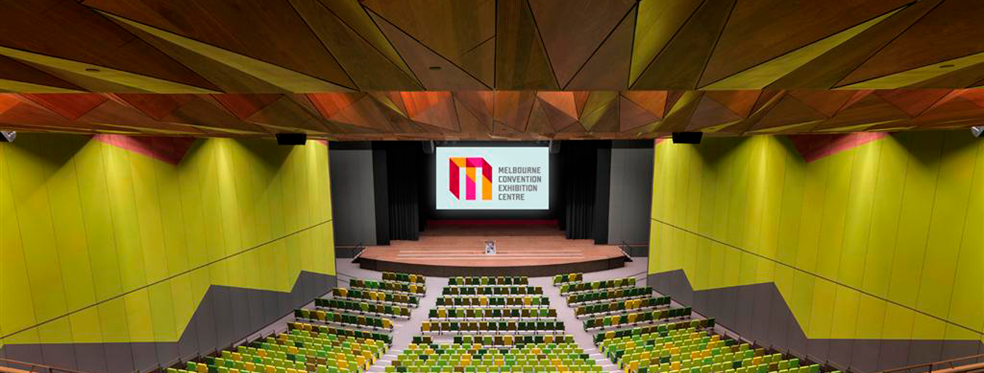
Presentation Venue – Plenary Chamber

Slide 16
Presentation Venue Technology
Wireless lapel mics
Laser pointer/slide clicker
(taking votes on traditional vs. IPAC’18 clickers)
Speaker-prep staff to allocate mics/clickers
Confidence monitor for speaker
Presentations set up and ready to roll in each session
Full on-call IT and AV staff provided by the venue

Slide 17
Speaker Ready
Vince’s tried-and-tested process and database will help process all presentations and speakers beforehand
Speaker-ready staff will check all presentations for fonts, images and videos being embedded properly
The presentation will be handed over to a dedicated venue staff member to check on their own replica setup of the auditoriums
Presentations then pushed out to each auditorium’s computer for each session

Slide 18
Editorial Office Setup
Each desk will have:
PC/Mac with 27” Display
Power for charging laptops/phones
Room for working with authors
The room will have
3x printers spread throughout the room
Large projector to display stats and information
Full conference wi-fi coverage for personal use

Slide 19
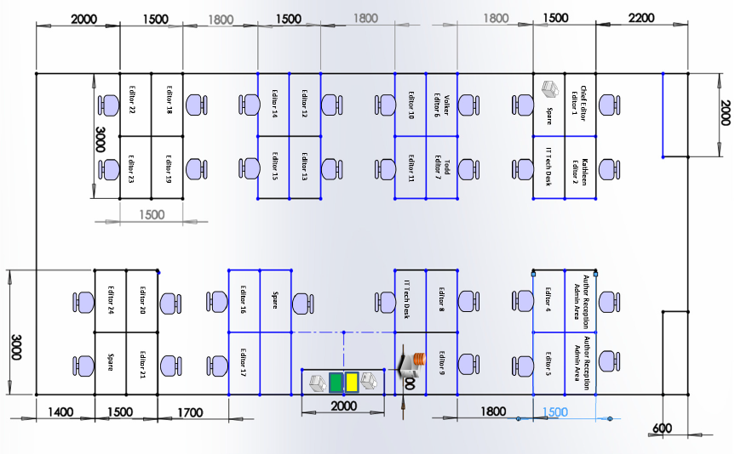
Editorial Office Layout

Slide 20
Looking forward to seeing everyone in Melbourne!
A MASSIVE thanks to Johan for delivering this presentation on our behalf.

