Slide 1
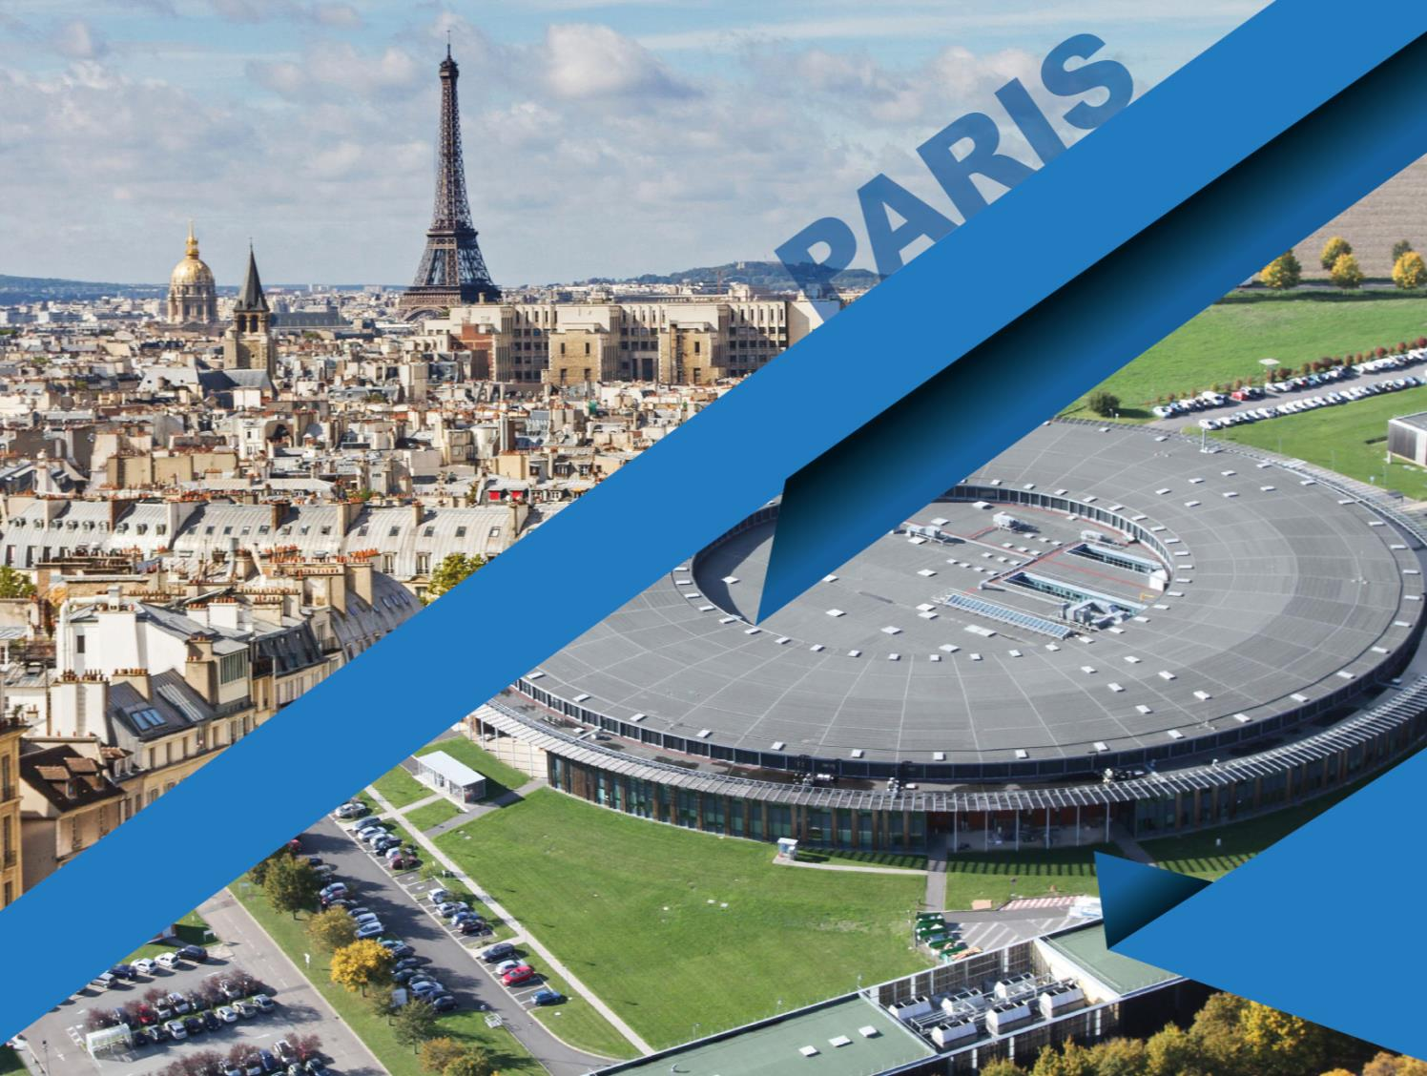

MEDSI 2018 : Synchrotron SOLEIL

Slide 2

MEDSI ?
Mechanical Engineering Design of Synchrotron equipment and Instrumentation
Biennial international conference since 2000:
      2000 : SLS (Zurich)
      2002 : APS (Chicago)
      2004 : ESRF (Grenoble)
      2006 : SPRING 8 (Riken)
      2008 : CLS (Saskatoon)
      2010 : DIAMOND (Oxford)
      2012 : SSRF (Shanghai)
      2014 : AS (Melbourne)
      2016 : ALBA (Barcelone)
      2018: SOLEIL (Paris)
      2020: APS (Chicago)
JACoW member only since 2015

Slide 3
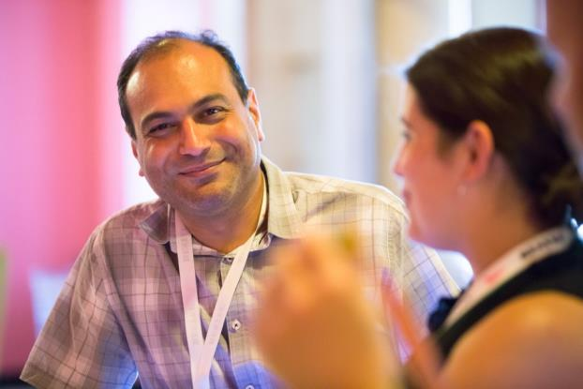
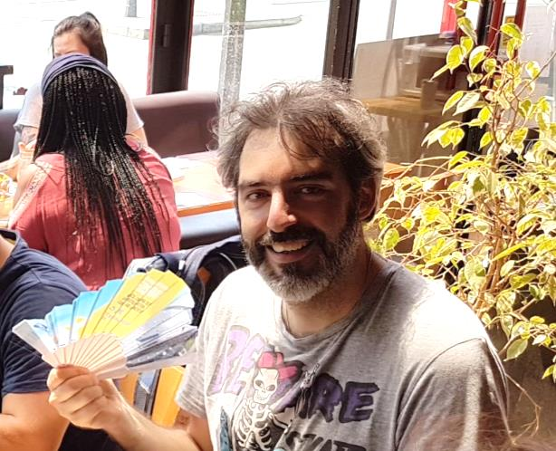
MEDSI 2018
Keihan TAVAKOLI
Conference and SP chair
Manuel TILMONT
JACoW Editor

Slide 4


MEDSI 2018

Slide 5
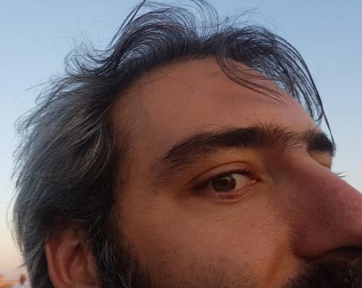
MEDSI 2018
October 2016:
The decision to host MEDSI’18 by Synchrotron SOLEIL
November 2016:
JACoW team meeting in Vancouver !!
No JACoW editor at SOLEIL, we were quiet lucky that Manuel has accepted this task. To be operational, he participated to:
  2016 Team Meeting
  IPAC 2017
  COOL 2017
  IPAC 2018
  Very difficult to find necessary funding…

Slide 6
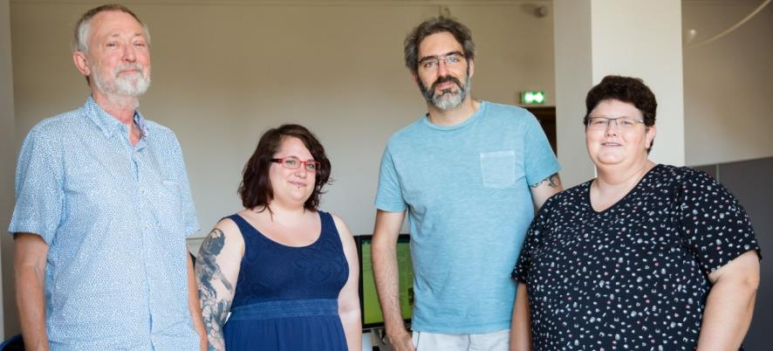
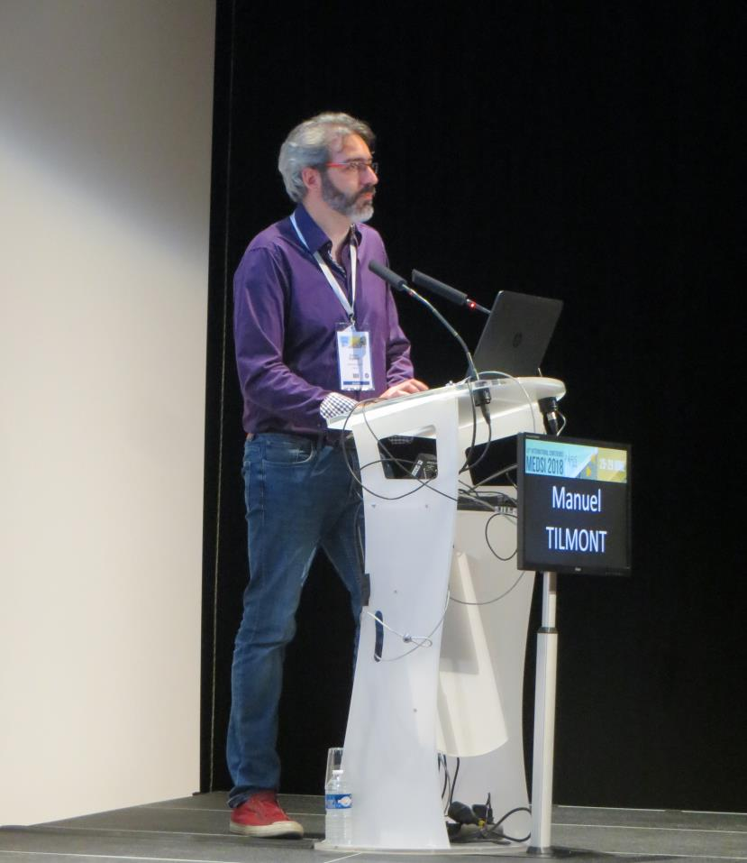
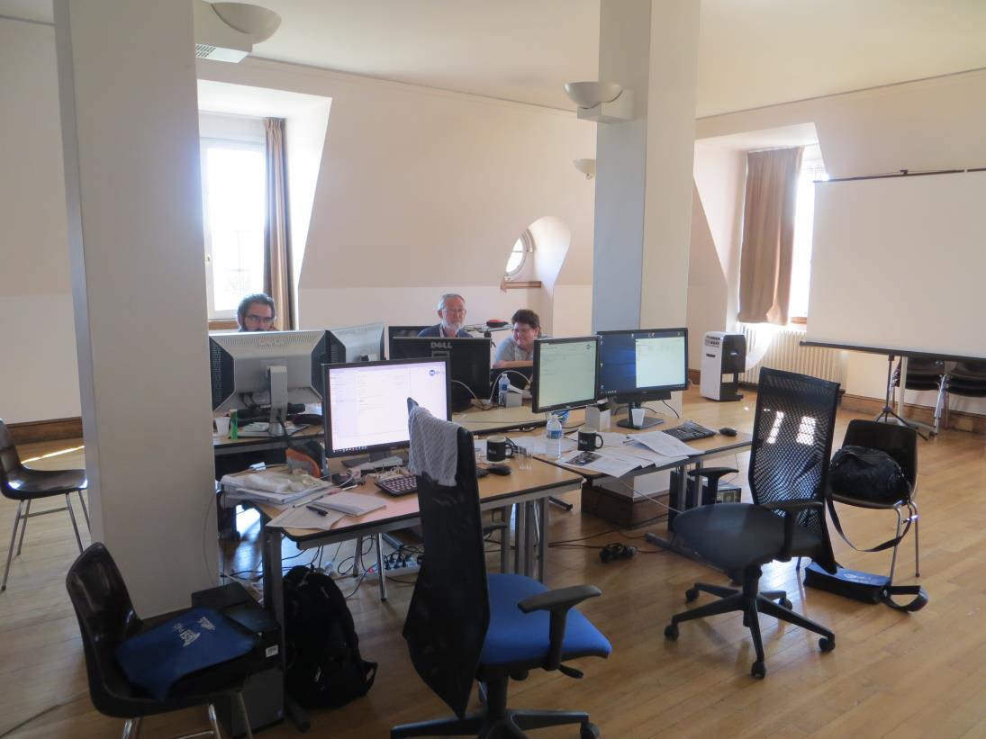
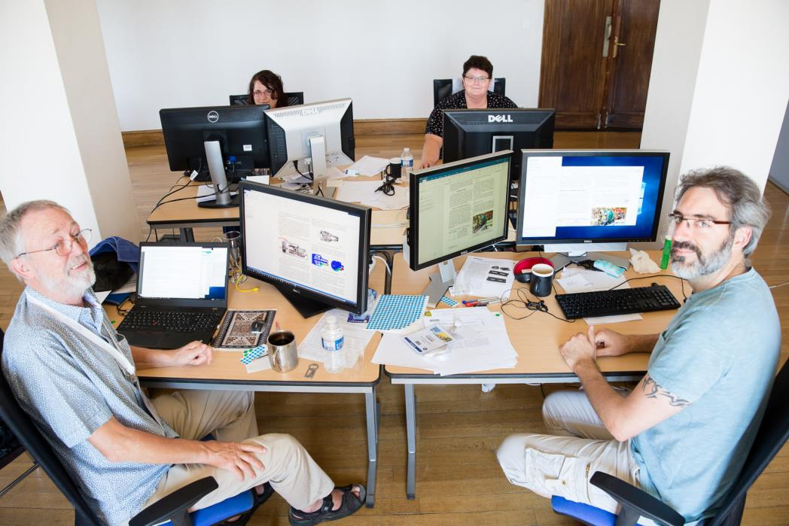
MEDSI 2018 Scientific Edition office
20 minute JACoW presentation during conference

Slide 7
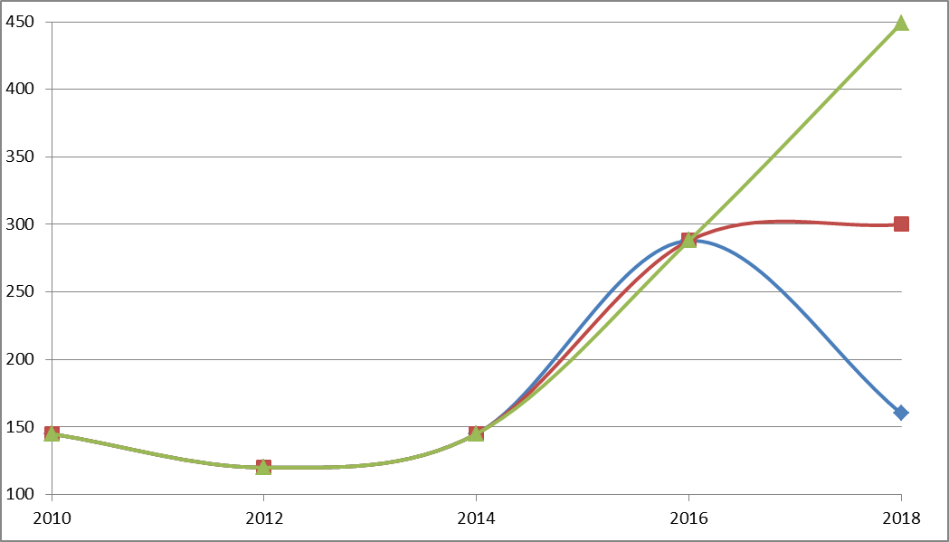
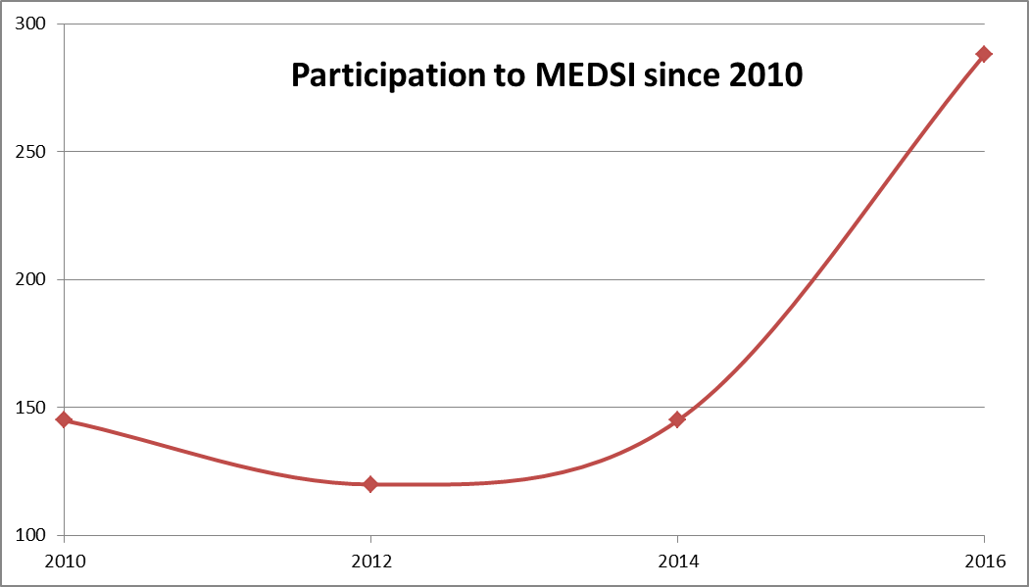
Organization difficulties
How many editors?
Which scenario ?!

Slide 8
Organization difficulties
How much did it cost?
Direct Costs (paid by MEDSI 2018)
Jacow room rental | 5200€
Air condition | 1000€
Independent Internet connection | 600€
Catering | 500€
Per Diem | 2000€
Accommodation for editors | 4000€
Editing setup | 1500€
Miscellaneous | 800€
TOTAL | 15,600€
Indirect Costs (Paid by SOLEIL)
Jacow editor travel expenses | 5000€
20% of a SOLEIL staff time | 20000€
TOTAL | 25,000€

Slide 9
MEDSI experience feedback
MEDSI 2016, Barcelona (1st MEDSI under JACoW)
Editor: David Lopez
Left ALBA after MEDSI !!
MEDSI 2018, Paris (2nd MEDSI under JACoW)
Editor: Manuel Tilmont
Left SOLEIL after MEDSI !!
IOC tries since 2014 to designate the next two MEDSI hosts but 4 years is too far for a mid-range conference like MEDSI

Slide 10
MEDSI experience feedback
Minutes of MEDSI 2018 IOC meeting:
There is no doubt that JACoW was very useful to MEDSI. We can observe a net improvement of submitted articles since MEDSI is an official partner of JACoW but the gain on investment ratio is less significant than expected.
There are some professional alternatives to JACoW scientific editing system which are more efficient, user friendly and cost effective.

Slide 11

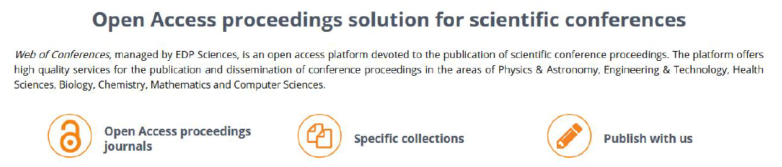
Alternatives
I have been approached by:

Slide 12
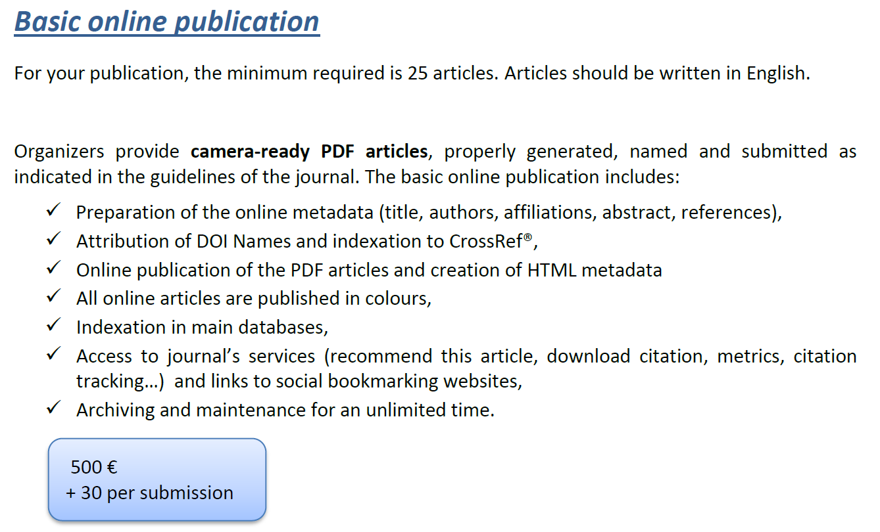
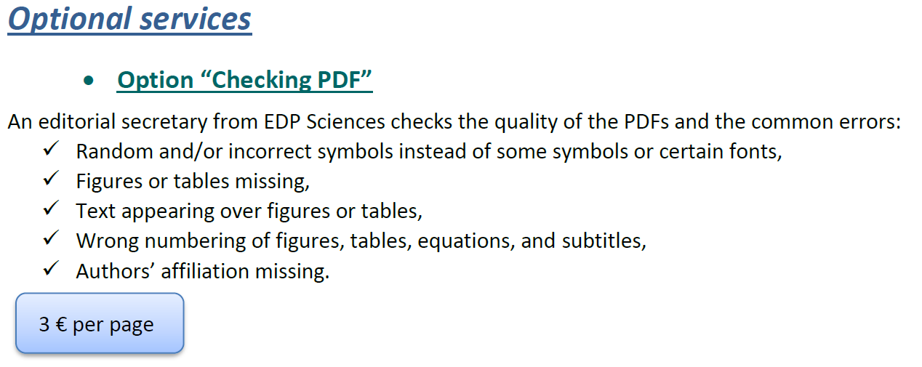
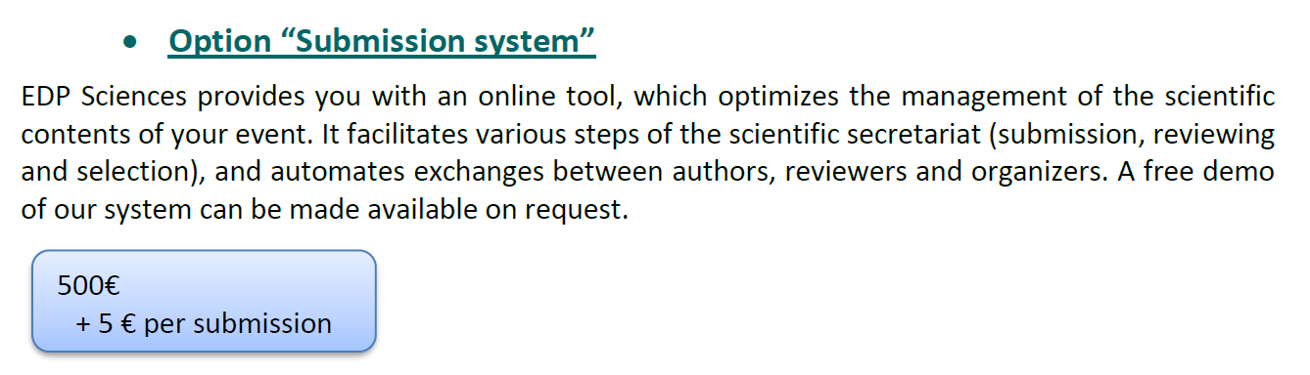
Alternatives
It would cost MEDSI around 8 k€….!

Slide 13
Conclusion
A net improvement of submitted articles since MEDSI is an official partner of JACoW
MEDIS has gained in international recognition
The type of profile to choose a JACoW editor is unclear for novice chairs
More direct communication between JACoW and the chair would be appreciated
A JACoW guide to novice chairman would be really reassuring
JACoW needs to be prepared for competition with private companies who propose an equivalent service
MEDSI has no plan to leave JACoW collaboration, we share our recent experience with JACoW for future improvements

