Slide 1
Presentations management
Takashi Kosuge
KEK

Slide 2
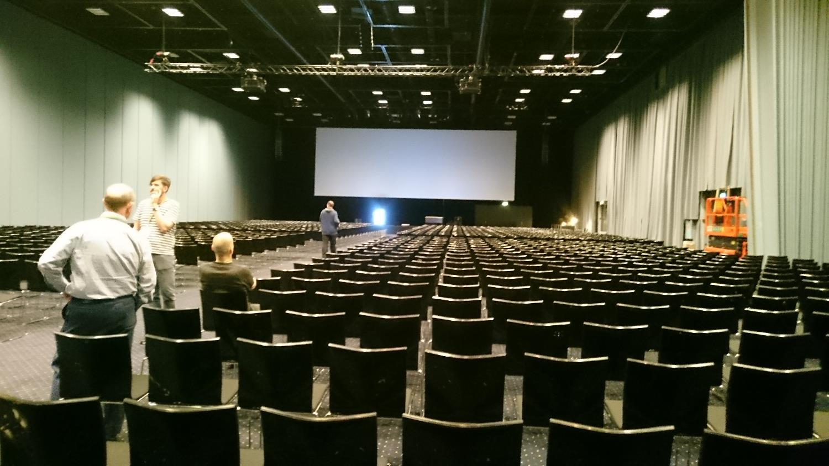
IPAC’17

Slide 3
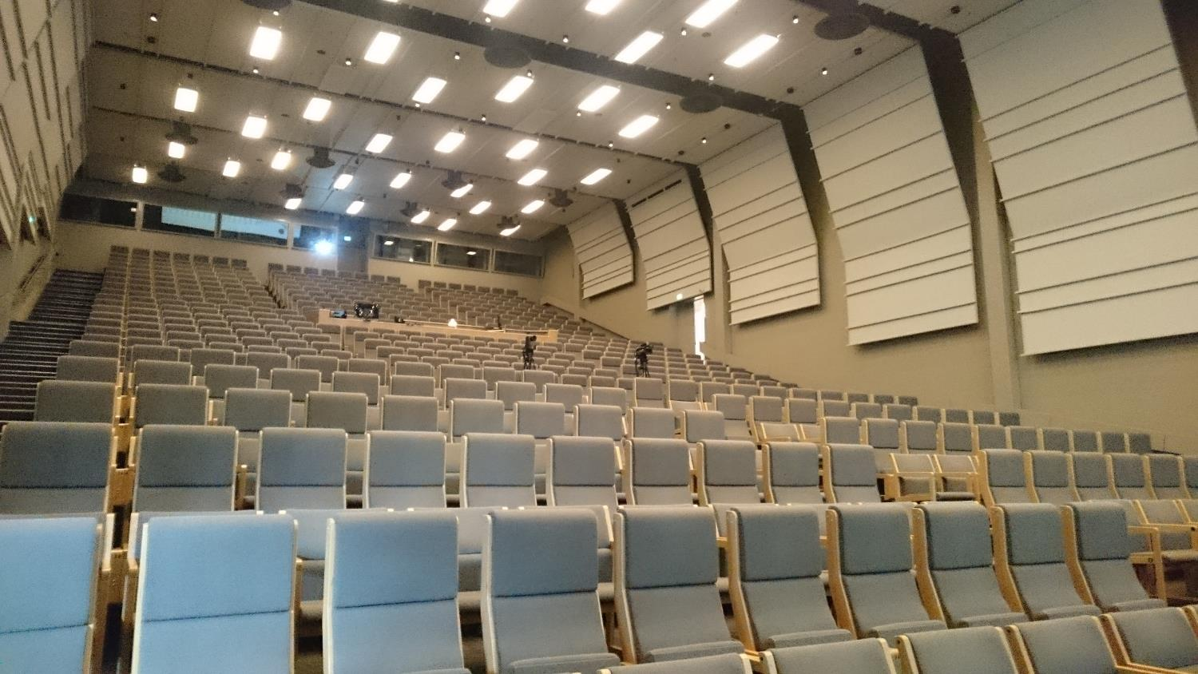
IPAC’17

Slide 4
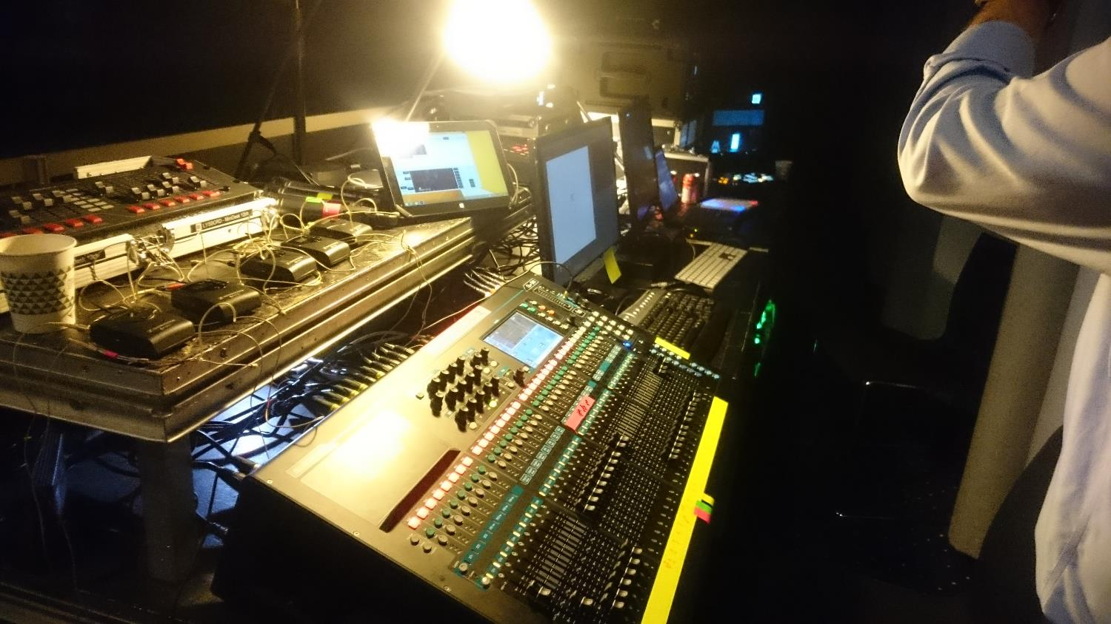
IPAC’17

Slide 5
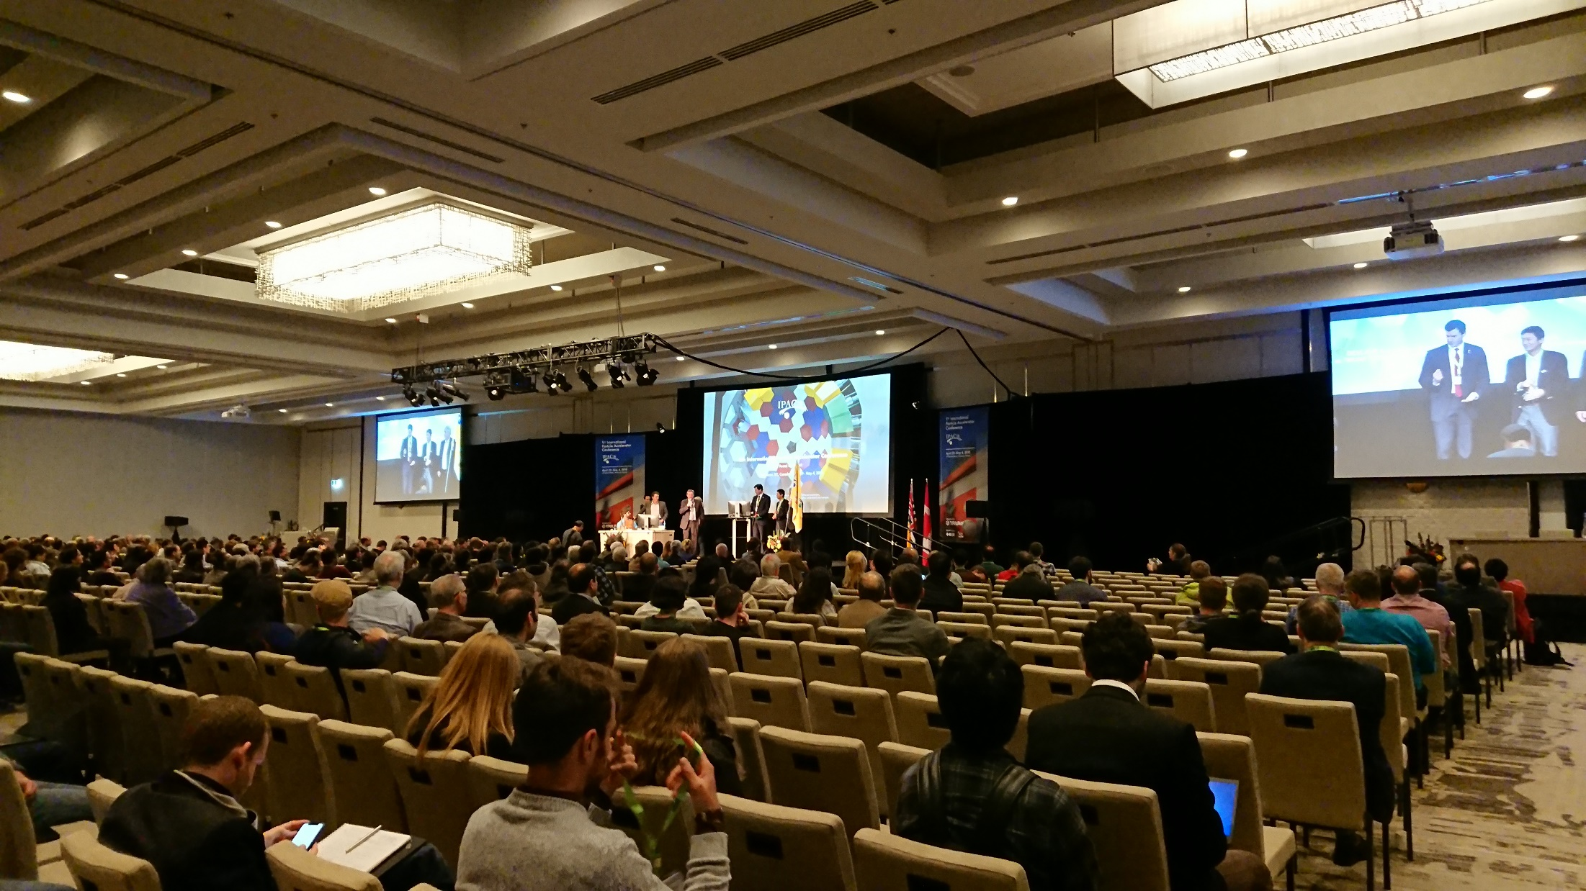
IPAC’18

Slide 6
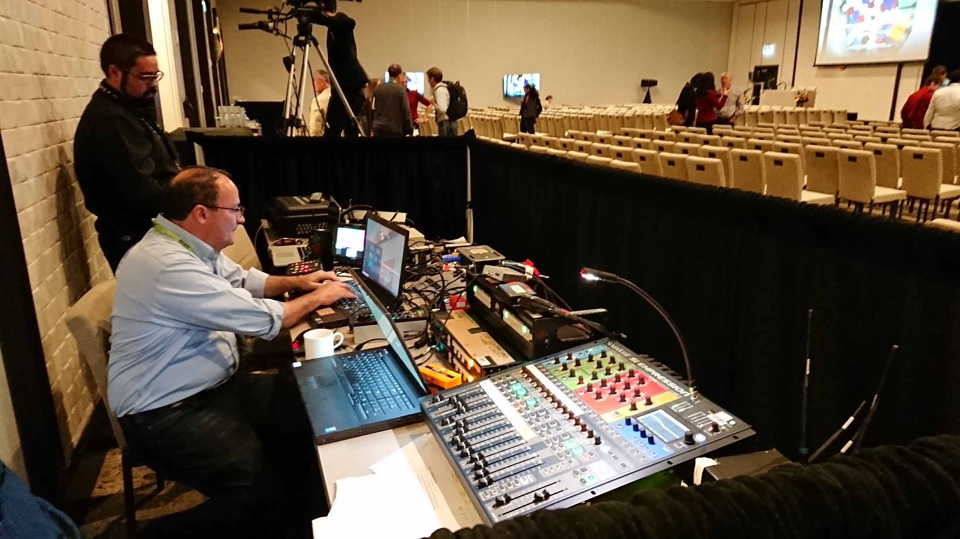
IPAC’18

Slide 7
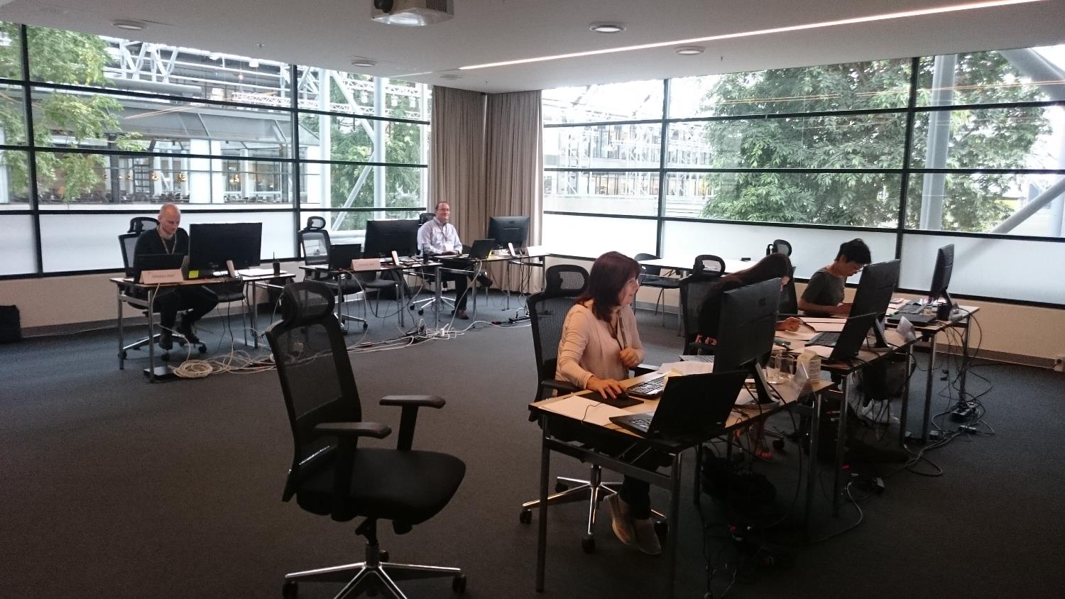
Speaker Preparation
Mikael Johansson (LOC)
Vincent G. Mitts
Takashi Kosuge
Author Reception
IPAC’17

Slide 8
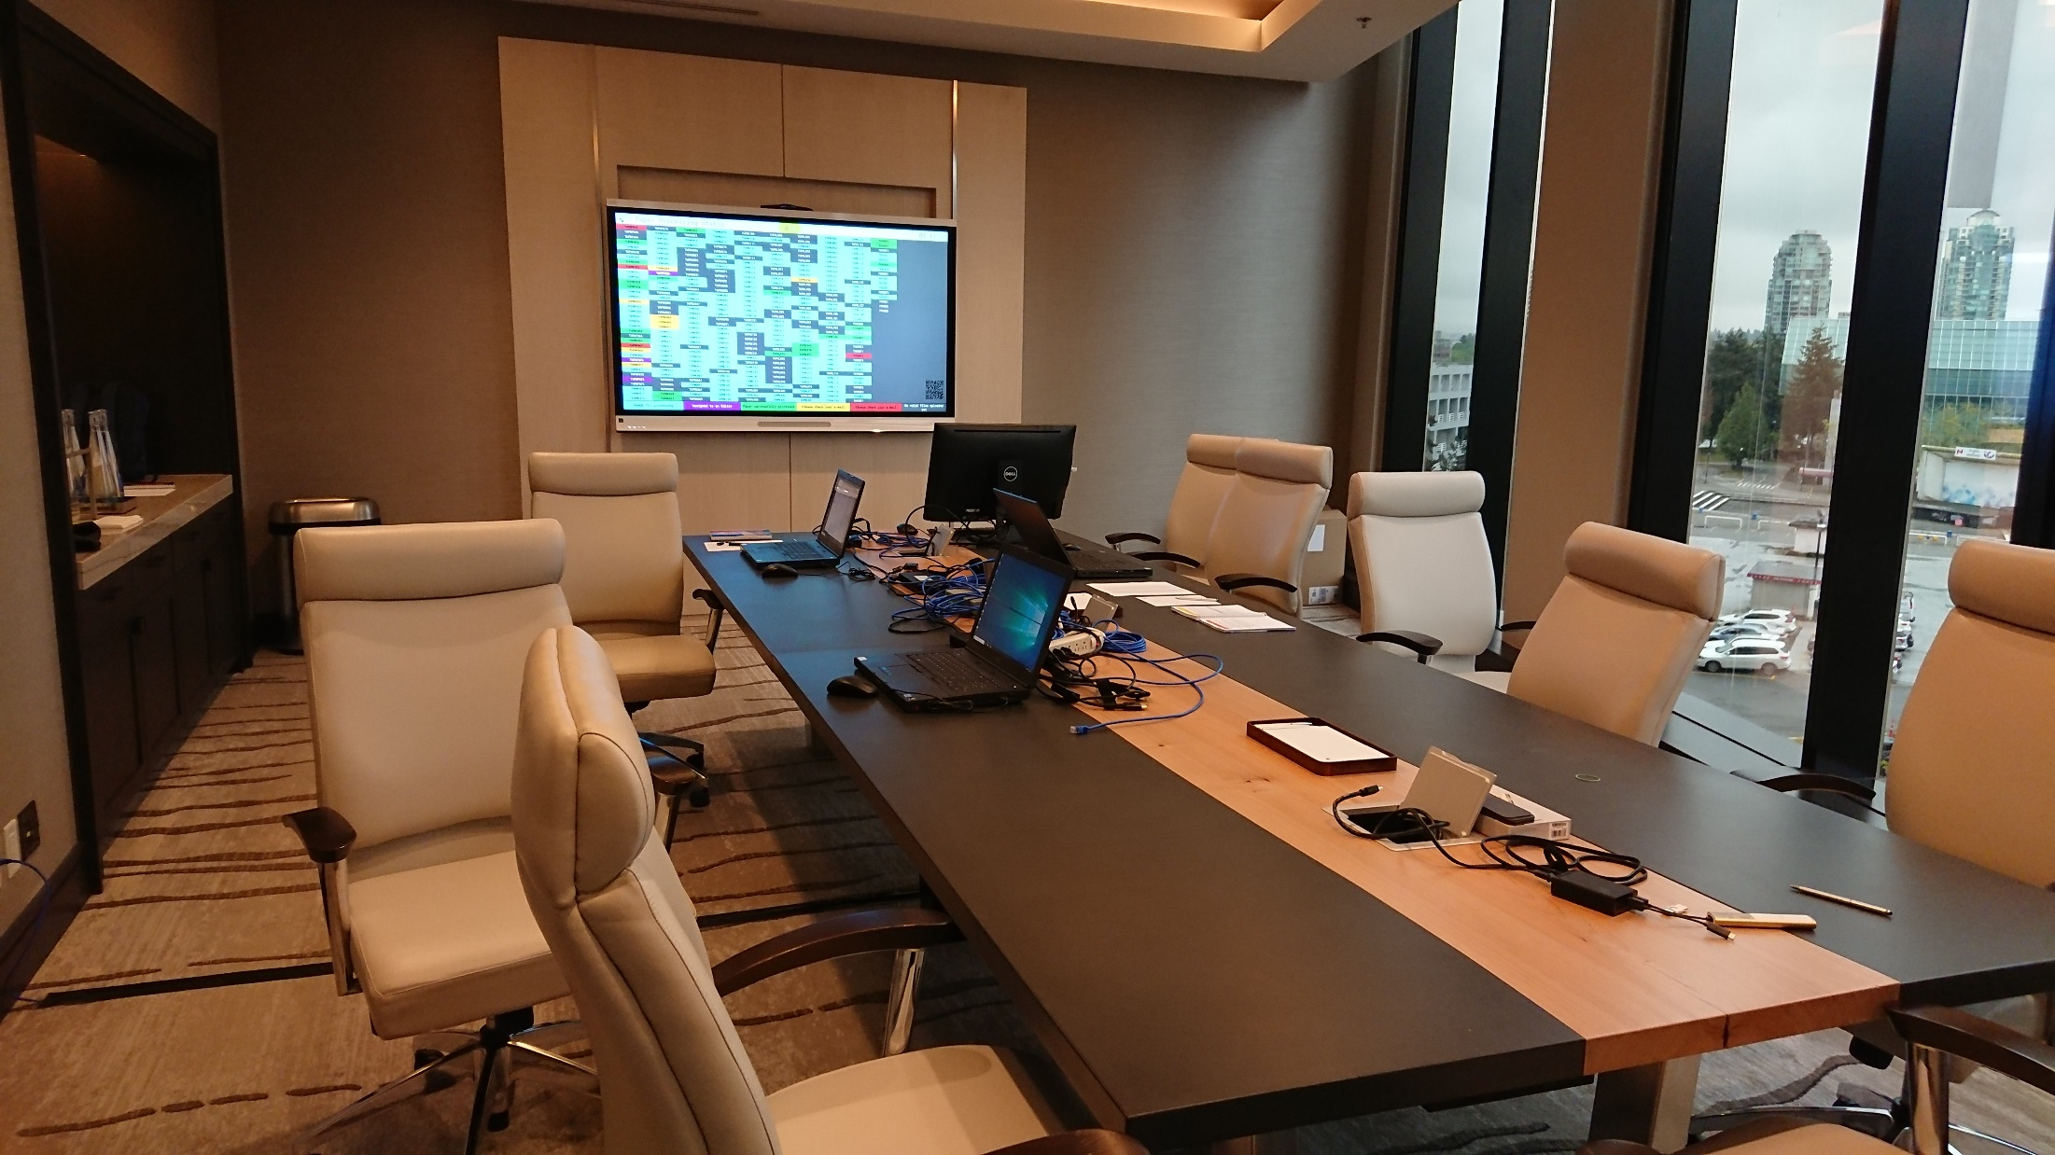
IPAC’18

Slide 9
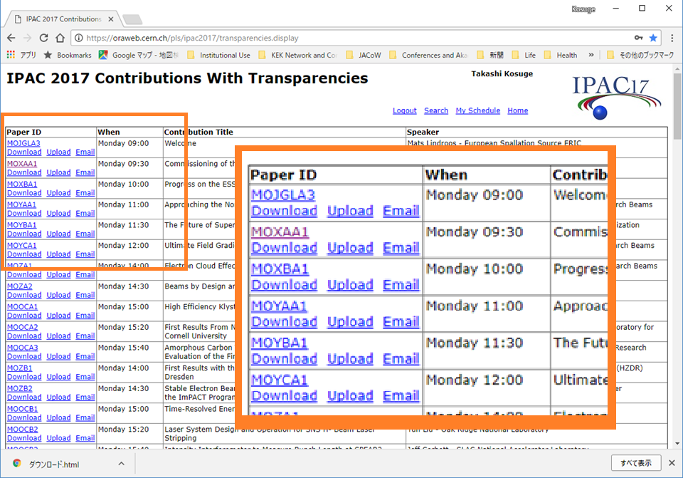

Slide 10
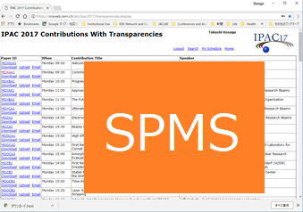
98 talks
Upload
If changed
Or with USB Stick
Check

Slide 11
Given instructions (managing the microphones in the auditorium, )to the students who received a grant to come to the conference by Michael.

Slide 12
Network: Enough speed to transfer large files. Windows network shares are used.
All speaker should come to Speaker Prep room before talk.
No USB drives will be accepted in the auditoriums
All presentations must be uploaded via SPMS half a day in advance of the presentation.

Slide 13
Checking talks (from Vincent’s report)
Video: .avi, .mp4, .m4v, .mov, .mpg, .mpeg, .wmv
Audio: .aiff, .au, .mid, .midi, .mp4a, .mp4, .wav, .wma
Fonts: Need to be embedded. Only True Type and Open Type fonts can be embedded.
http://www.jacow.org/JTM2016/
DebriefRunningofSpeakerPreparationPresentationManagement

Slide 14
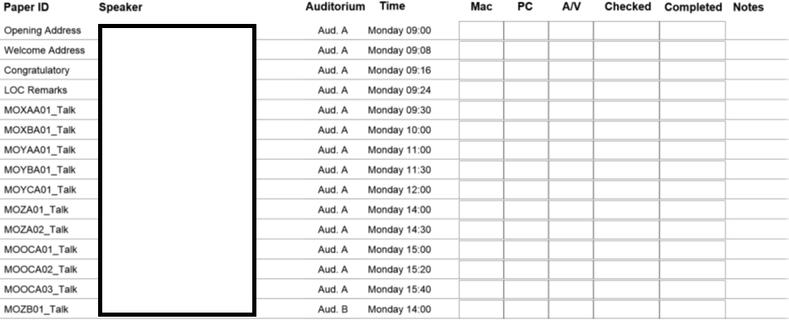
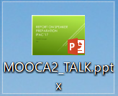
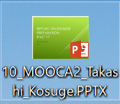
Order + Paper ID + Speaker + extension
=> 02_MOXAA01_First_Family.pptx
Order
And
Name
Check
Drag and Drop

Slide 15
Thank you.

